Slide 1



Slide 2



Slide 3

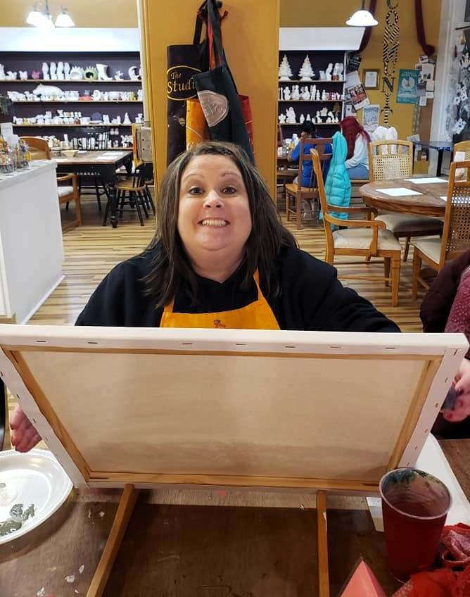
Kim Swartz
Accounting & Admin. Assistant
Dawn Eilert
Vice President

Slide 4
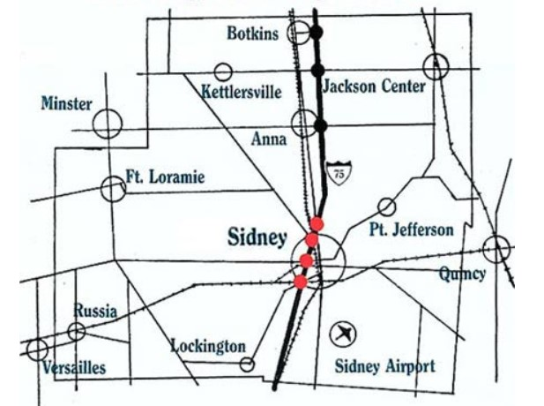



A review of growth and progress throughout Sidney & Shelby County

Slide 5
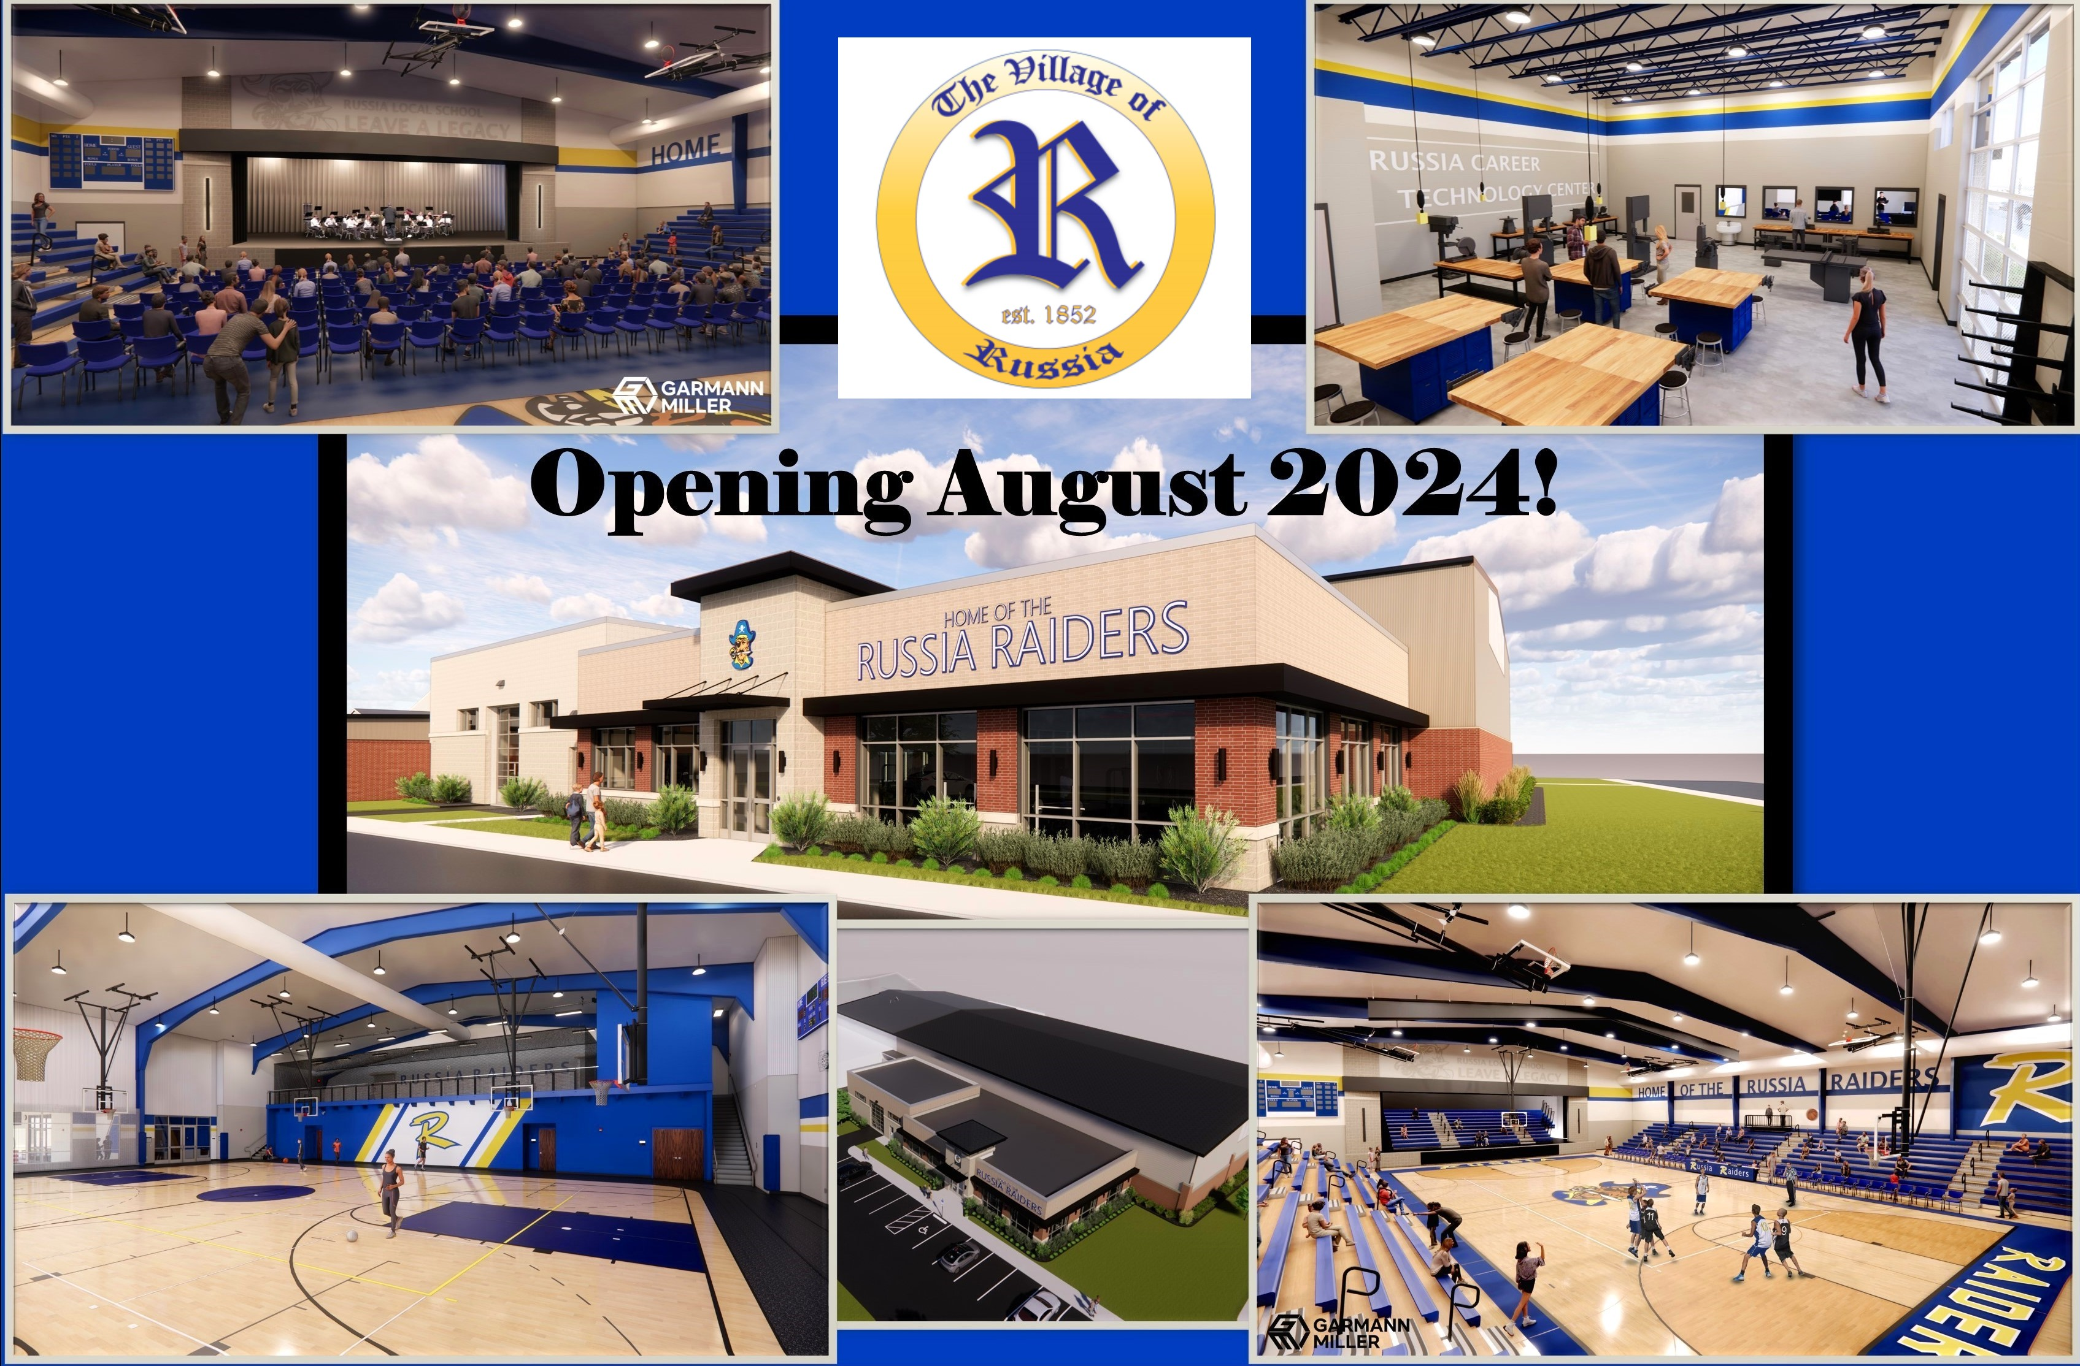

Slide 6
The residents of Russia are undertaking a major addition to their school. Together the community raised $3.4 million to outfit Russia School with a new Career Tech Classroom & Shop, a new Special Needs Preschool Classroom, a new Performing Arts Stage, a new Varsity Gymnasium, a new Multi-Purpose Gym, and a new Community Wellness Center all situated on the school’s campus. This work is expected to be completed by the opening of the 2024 school year.
Our friends at Francis Manufacturing and Superior Aluminum are nearing completion on facility expansions of their own adding capacity, which is always an encouraging sign in manufacturing. A new pavilion and splash pad are under construction at the Village Park along with an expanded walking trail. In terms of housing, two new condos have been constructed in the Village this past year with another to be finished soon.

Slide 7

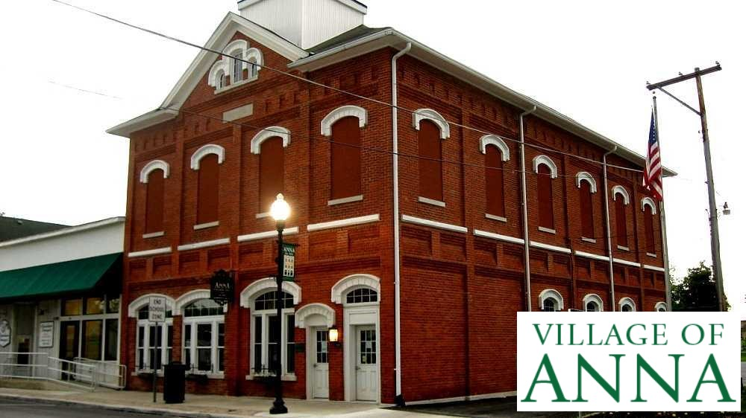

Slide 8
In Anna, the kids have a new splash pad in the park AND for all you pickleball players out there, the Village has plans to convert their tennis courts over to what is now the fastest growing sport in the United States, pickleball. For those who have yet to give pickleball try, DO IT. It’s great fun.
In addition, 3 new home permits were issued in the Village just last month adding to the 7 new homes constructed in the village last year. The new Timber Trail development has the potential for 23 additional new home sites.

Slide 9
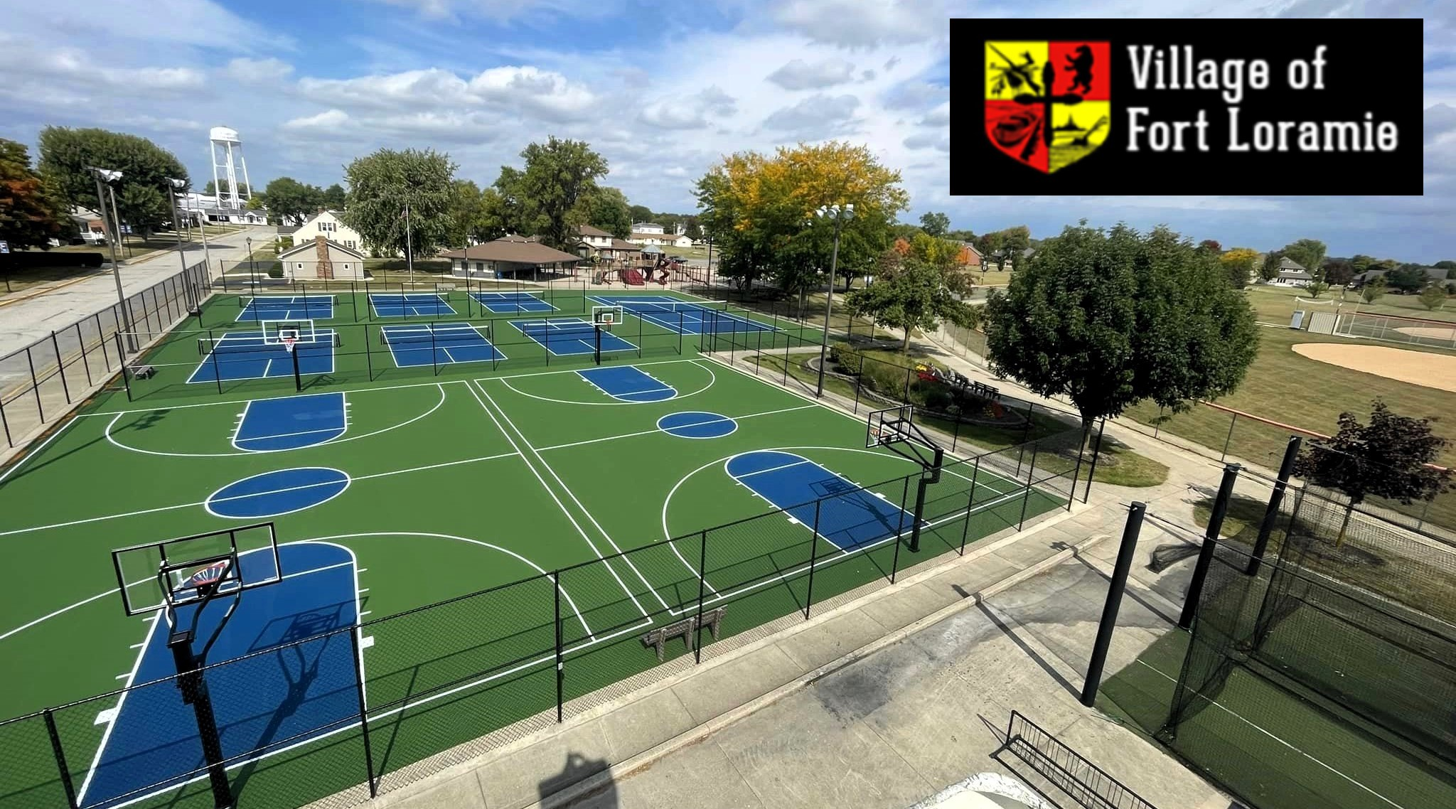


Slide 10
And speaking of pickleball, the Village of Fort Loramie added 6 beautiful new pickleball courts, a tennis court, and 2 basketball courts late last year.
The Village also recently announced the development plan for a new subdivision in 2024 with room enough for 26 new homes. Conversations have also begun with the Village of Minster to possibly construct a bike path connecting the two villages. Conversations have also commenced to expand the Industrial Park in Fort Loramie.

Slide 11
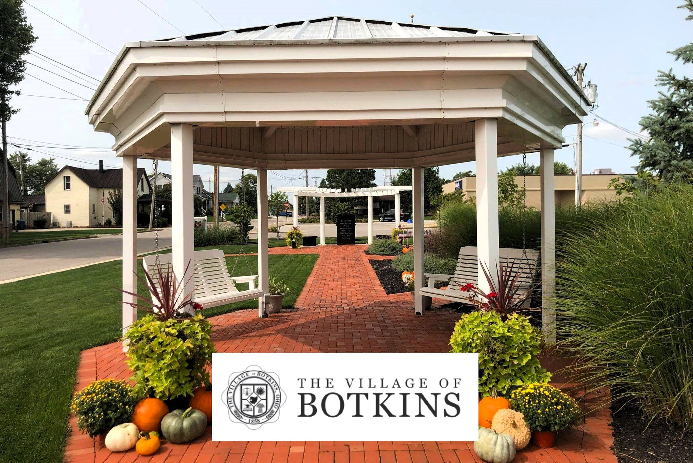


Slide 12
In Botkins, Village Administrator Randy Purdy tells me they’ve made some remarkable strides in both commercial and residential development, along with substantial investments in their community's infrastructure.
Koenig Equipment recently completed a noteworthy expansion at their facility aimed at enhancing aesthetics and improving accessibility. Earlier this year May PT unveiled their new facility at the Botkins Industrial Park where Eric and his team are providing top-notch physical therapy, fitness, and wellness services.
In 2023, Hageman Woods Estates began to take shape and is now platted for as many as 25 new homes. 6 of those building lots have already been sold with construction to begin soon.

Slide 13
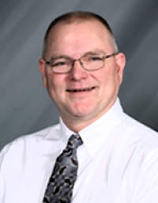
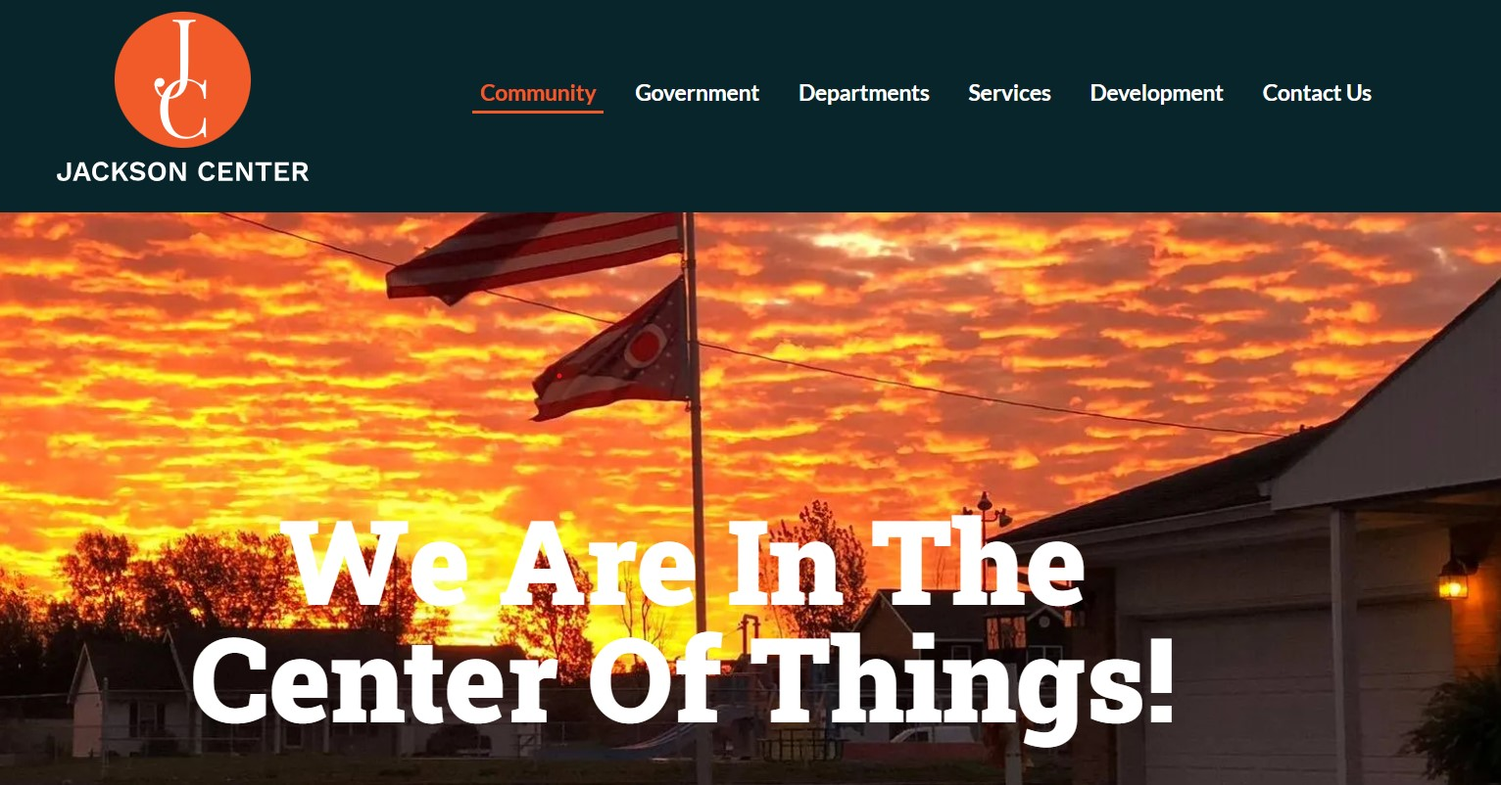

Congratulations on your retirement Bruce
Thanks for the memories…

Slide 14
And what about Jackson Center you ask? A new 5-unit condominium was constructed last year along with 4 new homes. In addition, Hudson Lake Developers are nearing completion of their Phase 3 subdivision bringing 24 additional new home lots to the Village.
Sip & Stream coffee and sandwich shop is set to open this Spring on Pike Street following the relatively recent opening of Mama J’s Pizza shop this past December. Curly’s Meats will be opening their new 27,000 square foot processing facility any day now and its retail storefront will open this Summer.
Still more, the Village is now taking bids on what is estimated to be a new $3.6 million Water Treatment Plant to serve the growing needs of the residents and businesses in Jackson Center.
Lastly, I’d like to congratulate retiring Village Administrator Bruce Metz on a long and successful career in Jackson Center.

Slide 15



Slide 16
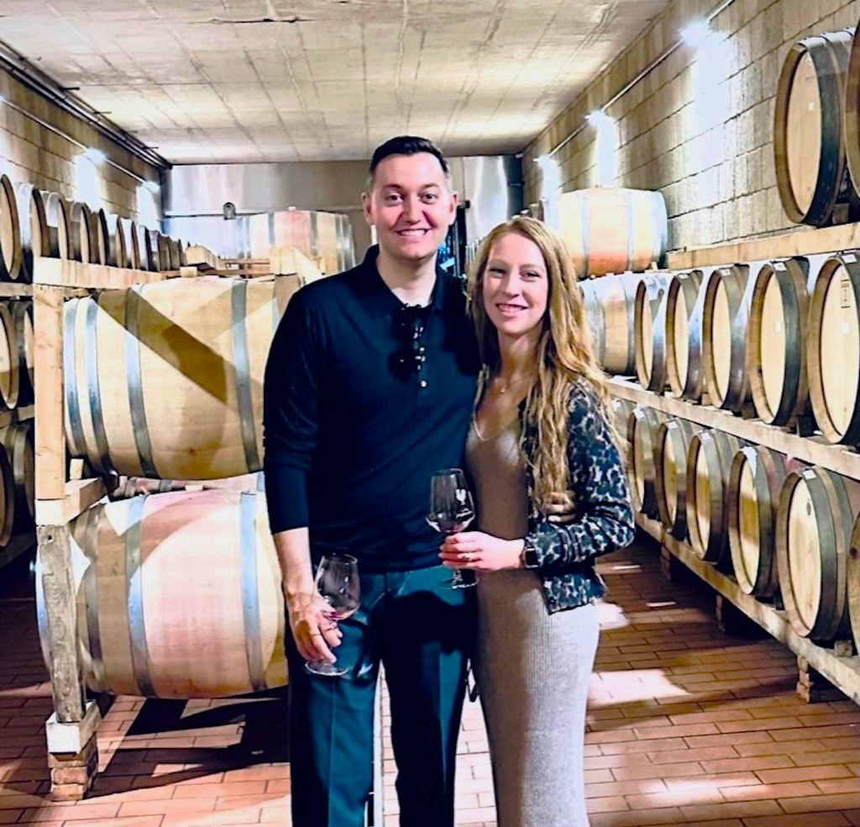

Andrew Bowsher
City Manager
City of Sidney, Ohio

Slide 17


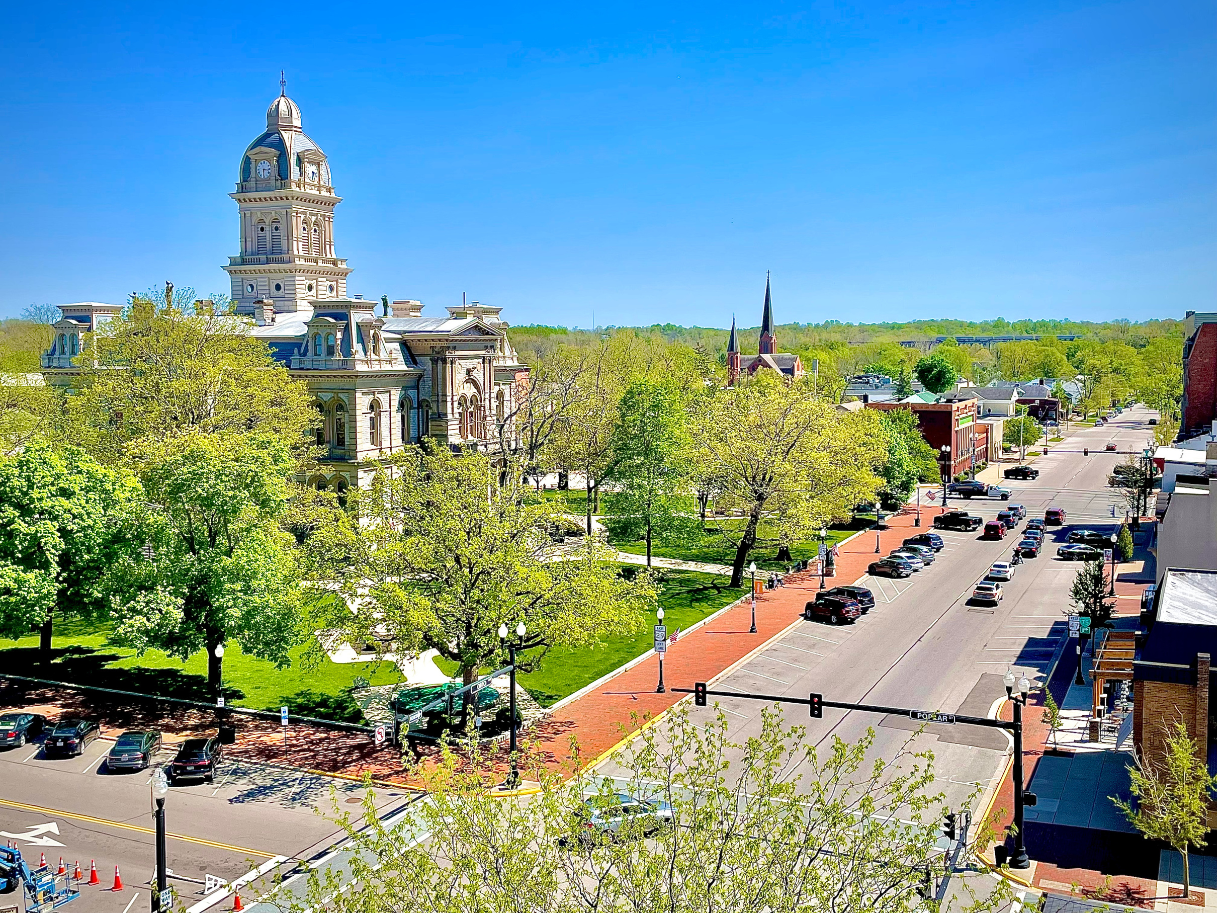
The City of
Sidney
Sidney,
Ohio
Reporting on our
Progress and Milestones

Slide 18



Priorities
In the grand scheme of the City, and its priorities, outlined are the major projects underway, in an effort to meet the council and community goals.
Housing
Housing growth and development. Both within the downtown core and in the outer peripheral areas.
Downtown
Redevelopment opportunities of key structures and buildings within the downtown, and traditional neighborhood areas.
Trails / Parks
Transit growth, with enhanced bike and pedestrian access and an environmental emphasis, with renewed parks and recreation facilities. - Parks Master Plan 2023 / Canal Feeder Trail expansion
03
City of Sidney, 2024

Slide 19



Priorities
Enforcement
Target code enforcement. Becoming proactive rather than reactive. Focus energy on bad actors, while cleaning up our neighborhoods, including our Vacant Property Registration, Rental Registration programs.
Development
Target infill projects at key nodal intersections and major corridors. To include Rt. 47, Vandemark, Fair Rd, and Russell.
Financial
Continue to be fiscally conservative and be good stewards of the taxpayer's dollars.
04
City of Sidney, 2024

Slide 20

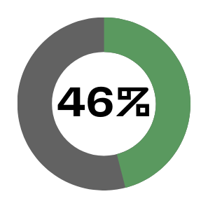
By The Numbers
11,600
Total number of commuters coming to our City, daily.
Percentage of Manufacturing Jobs
City of Sidney, 2024

Slide 21
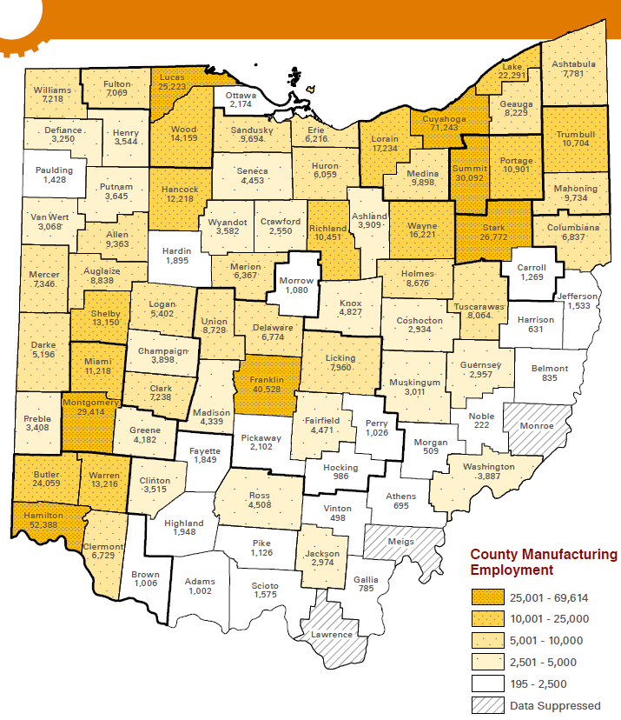


Most manufacturing jobs per capita
Site Selection - Top Micropolitan #3
We build stuff!

Slide 22


By The Numbers
1200
50
Total number of new homes under development
Number of Years, since this kind of growth
City of Sidney, 2024

Slide 23
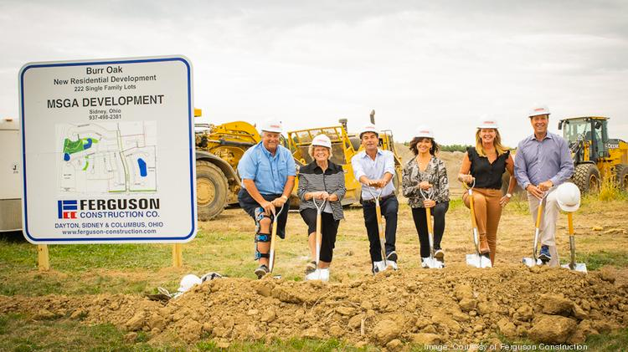
City of Sidney, 2024
Major Projects
Burr Oak
Greenfield Development
  222 single-family residences
  70 Acres of Commercial Retail
  22 Acres of Multi-family
8

Slide 24
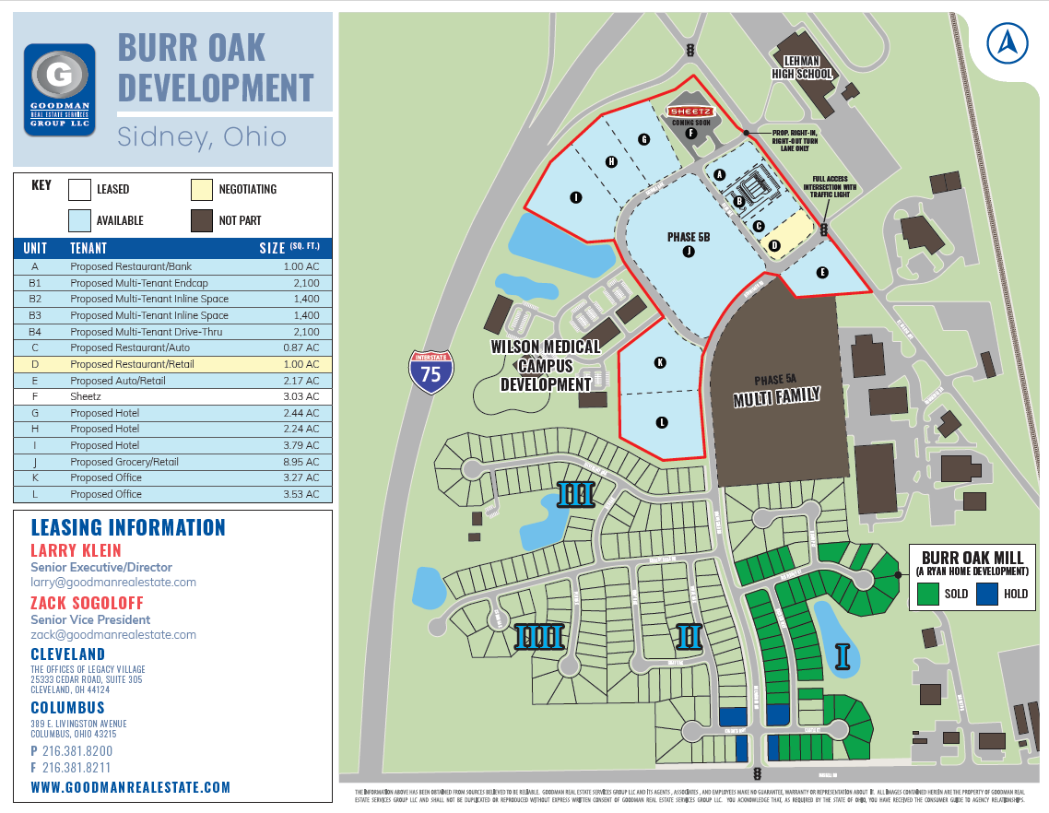

Slide 25
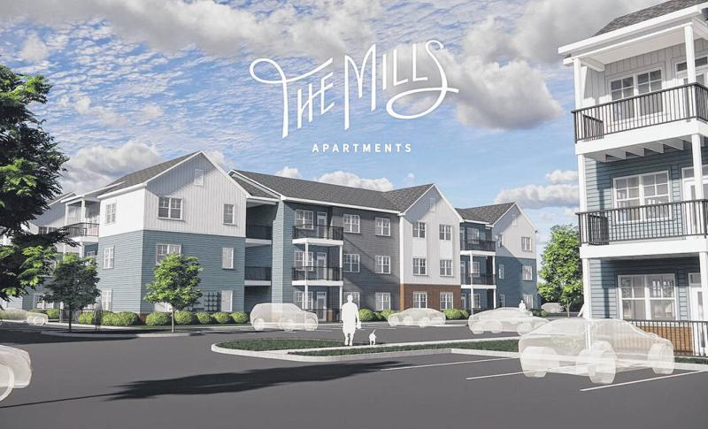
City of Sidney, 2024
Major Projects
The Mills
Greenfield Development
  $50M Investment
  216 Residences
  Crawford Hoying - JBM
  Ground Breaking 1/31/24
7

Slide 26
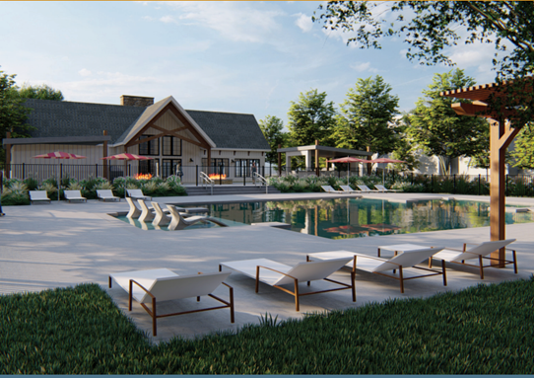
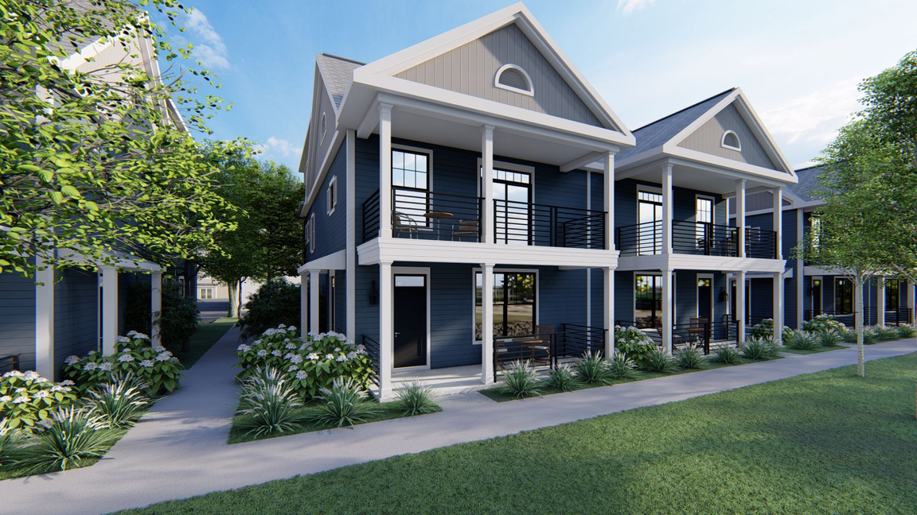
City of Sidney, 2024
Major Projects
Vision Development
Greenfield Development
  $75M Investment
  330 Residences in 2 Phases
  Vision Development
  Ground Breaking Mid-2024
7

Slide 27
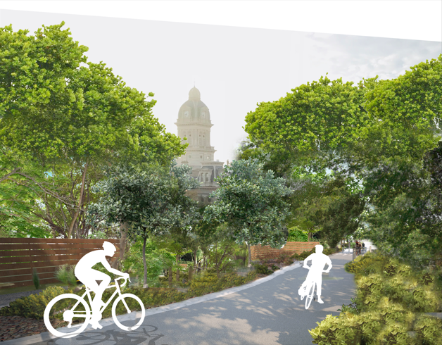
City of Sidney, 2024
Major Projects
Riverway Trail
Continued Trail Expansion
  Expansion South to Lockington/Piqua
  Expansion into Downtown and Tawawa Park

Slide 28
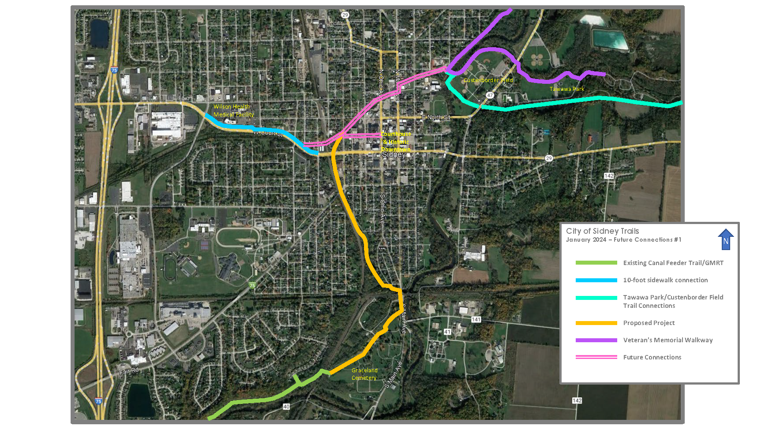

Slide 29
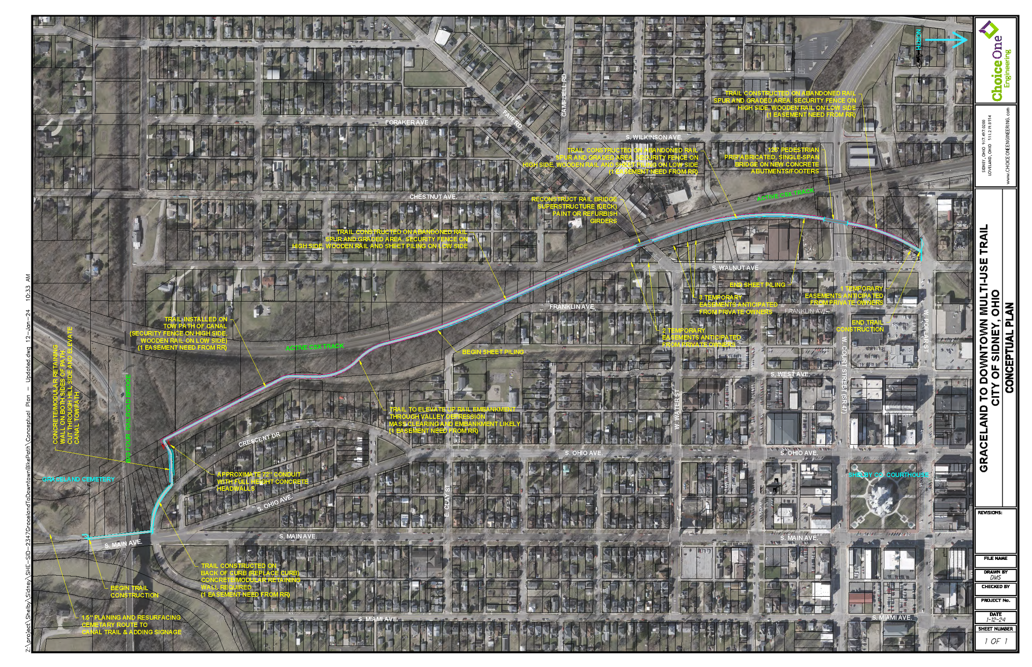

Slide 30


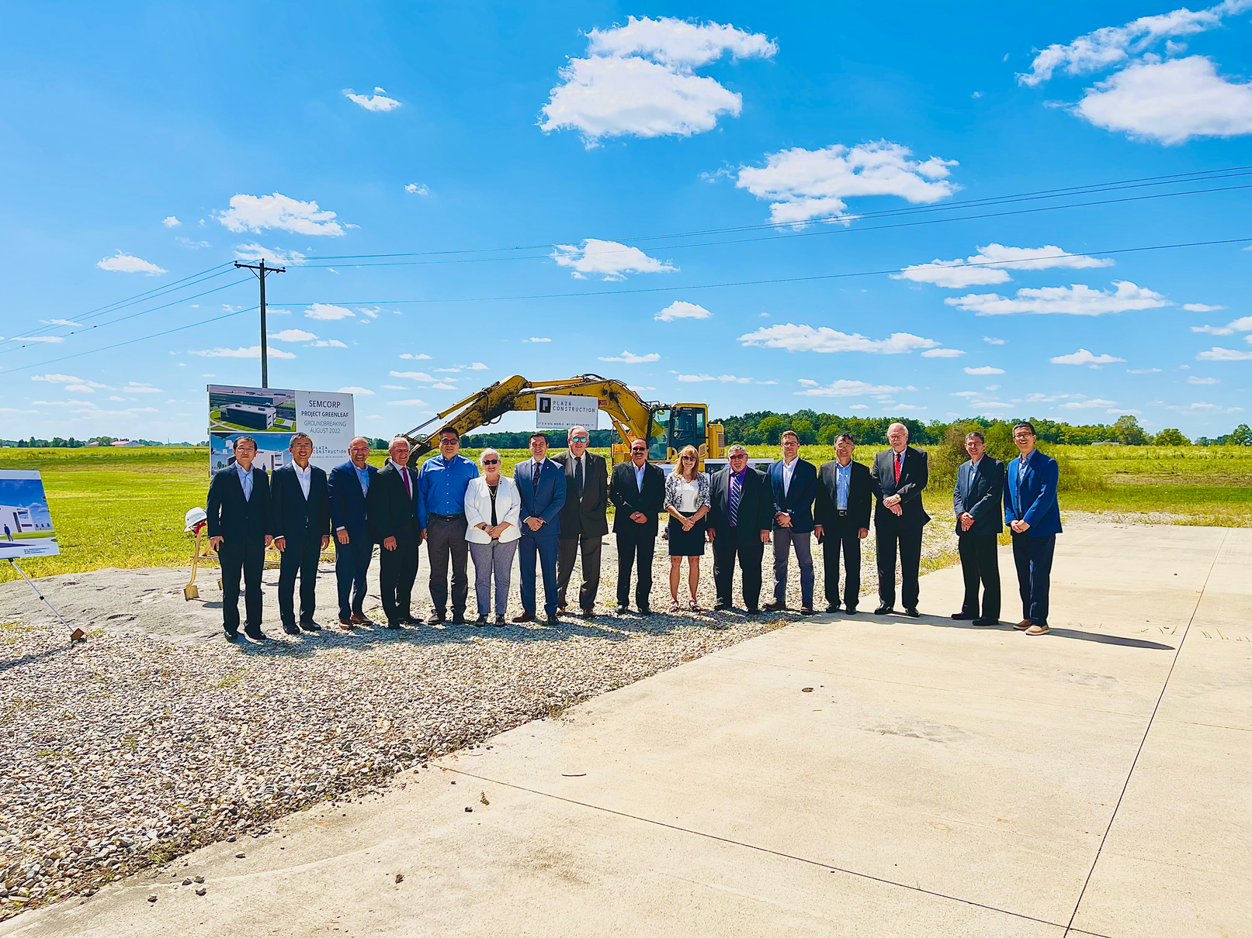
City of Sidney, 2024
Major Projects
SEMCORP
Economic Development
  1200 Jobs - Phase 1
  1 Billion Initial Investment
  $74 Million Payroll
13

Slide 31
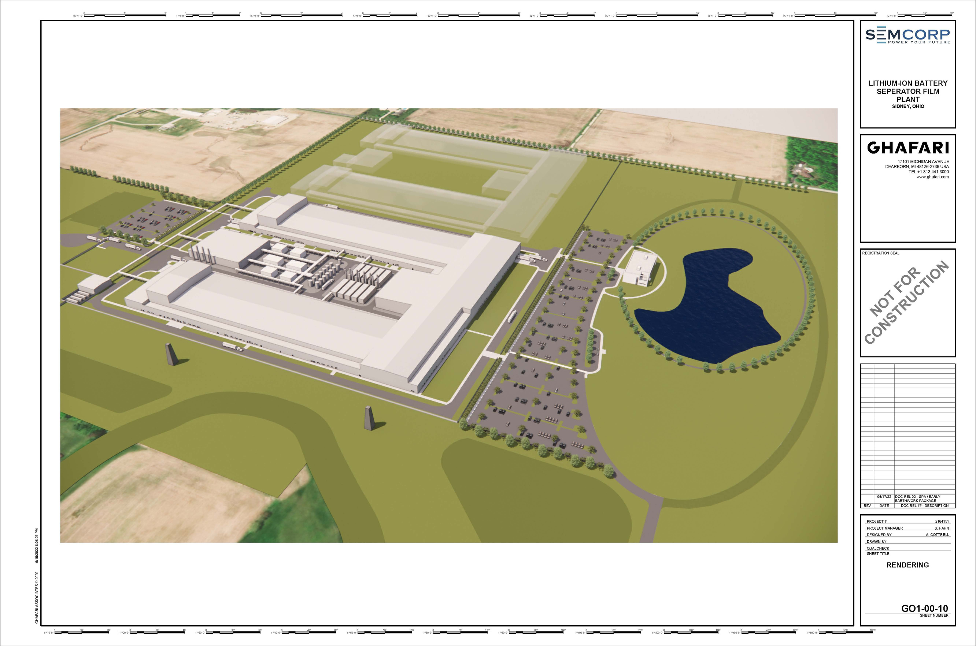

Slide 32
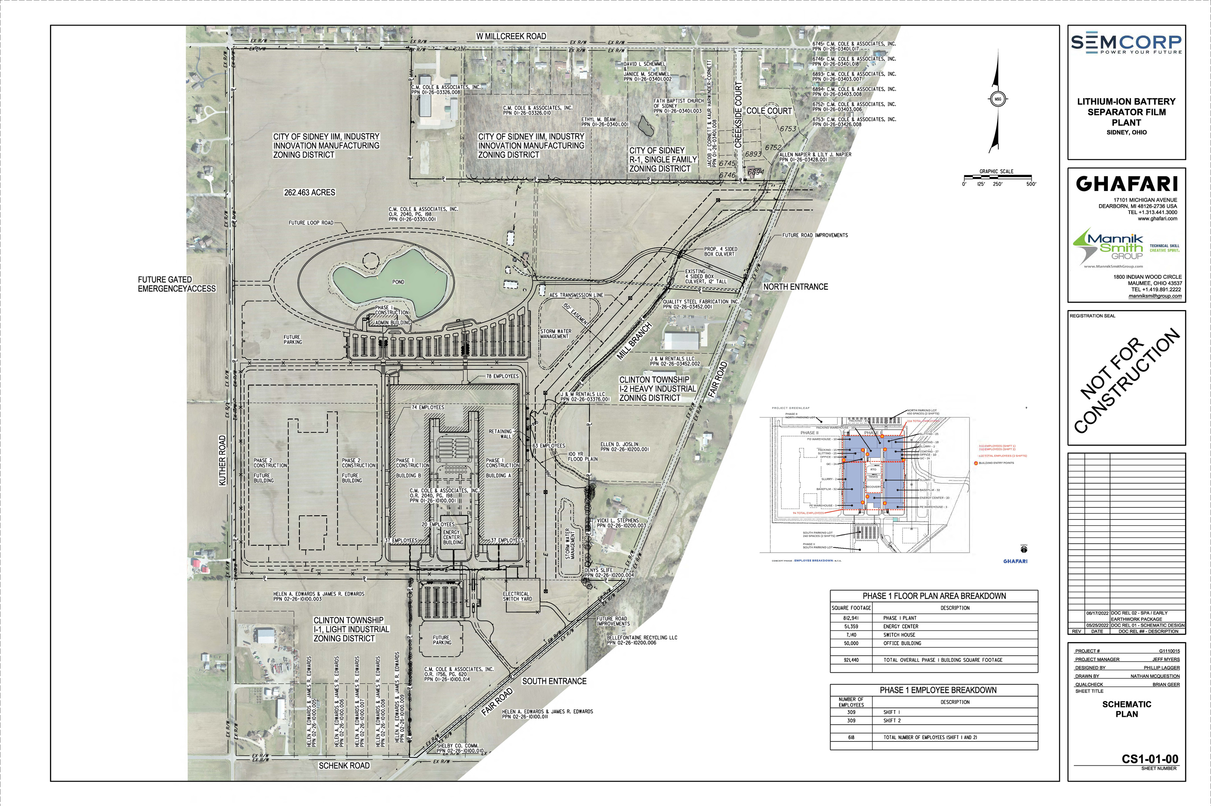

Slide 33
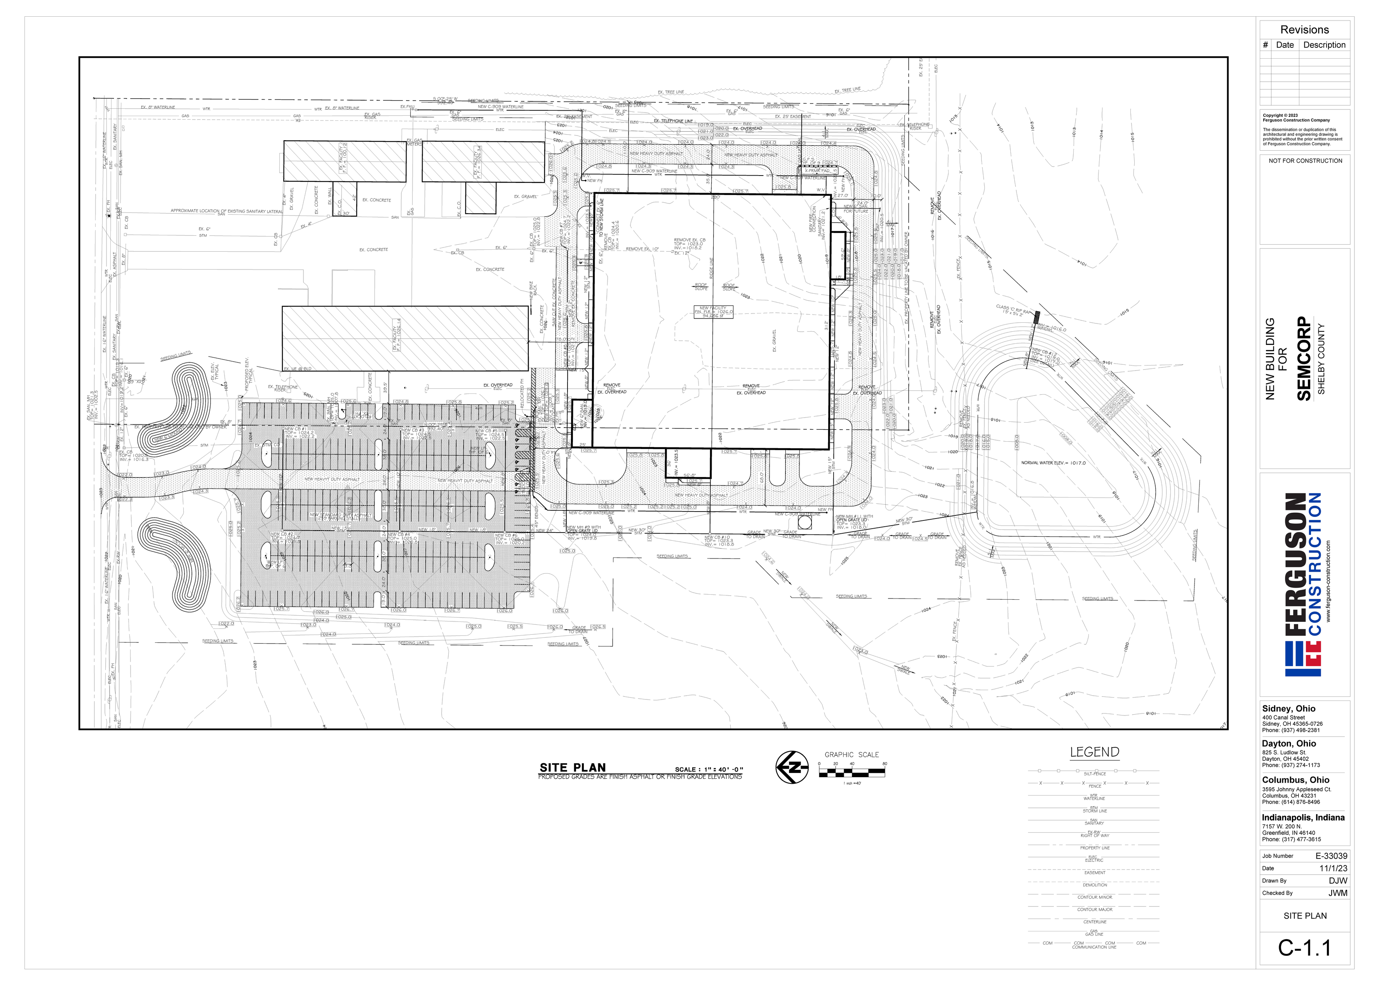
SEMCORP
Burlington Development
  300 Jobs - Phase 5
  100 Million Investment
  $18 Million Payroll

Slide 34

City of Sidney, 2024
Major Projects
I-75 Enhancement Plan
Beautification
  Interchange Facelifts
  Rt. 47 Improvements
  Landscaping Plan
17

Slide 35
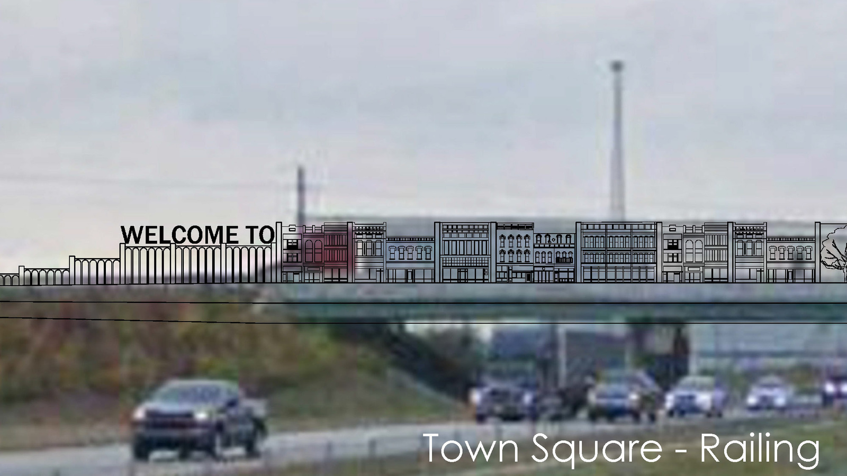
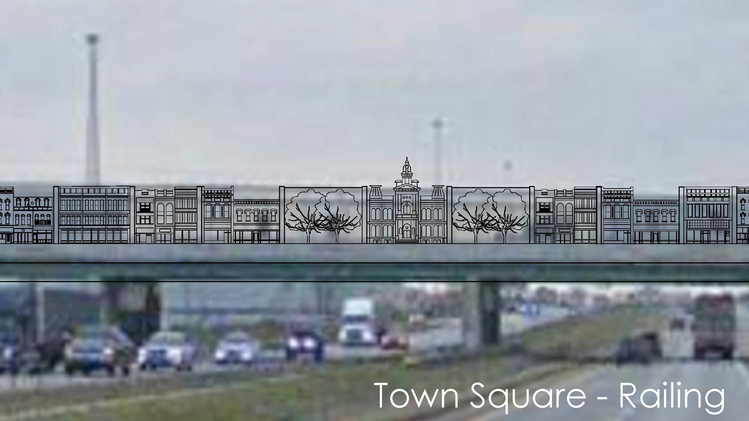

Slide 36
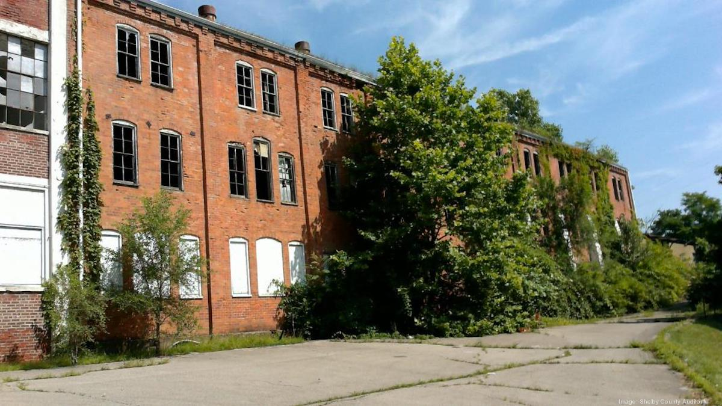
City of Sidney, 2024
Major Projects
WagnerWare
Brownfield
  $4.6M
  2M Grant from ODOD
  City and County Funds
  County Land Bank
19

Slide 37
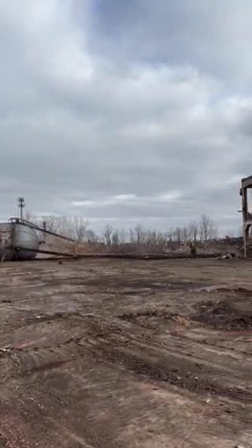

Slide 38
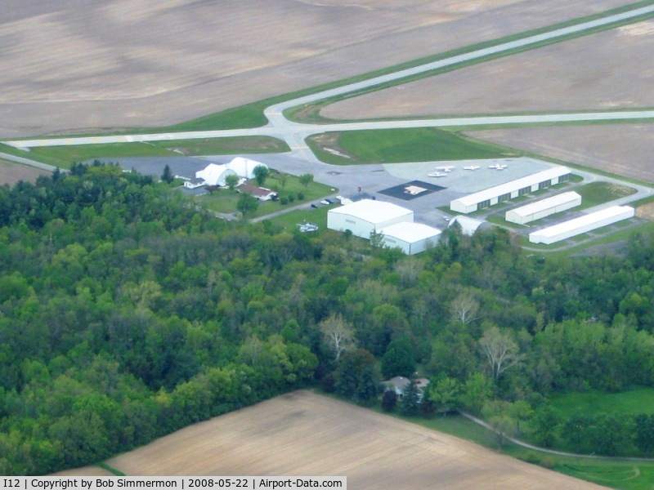
Major Projects
Sidney Airport
Expansion and Growth
  $4.2M Grant - Parallel Taxiway
  $7.5M Water / Sewer Expansion
  Federal/State Funding
  Advanced Air Mobility

Slide 39
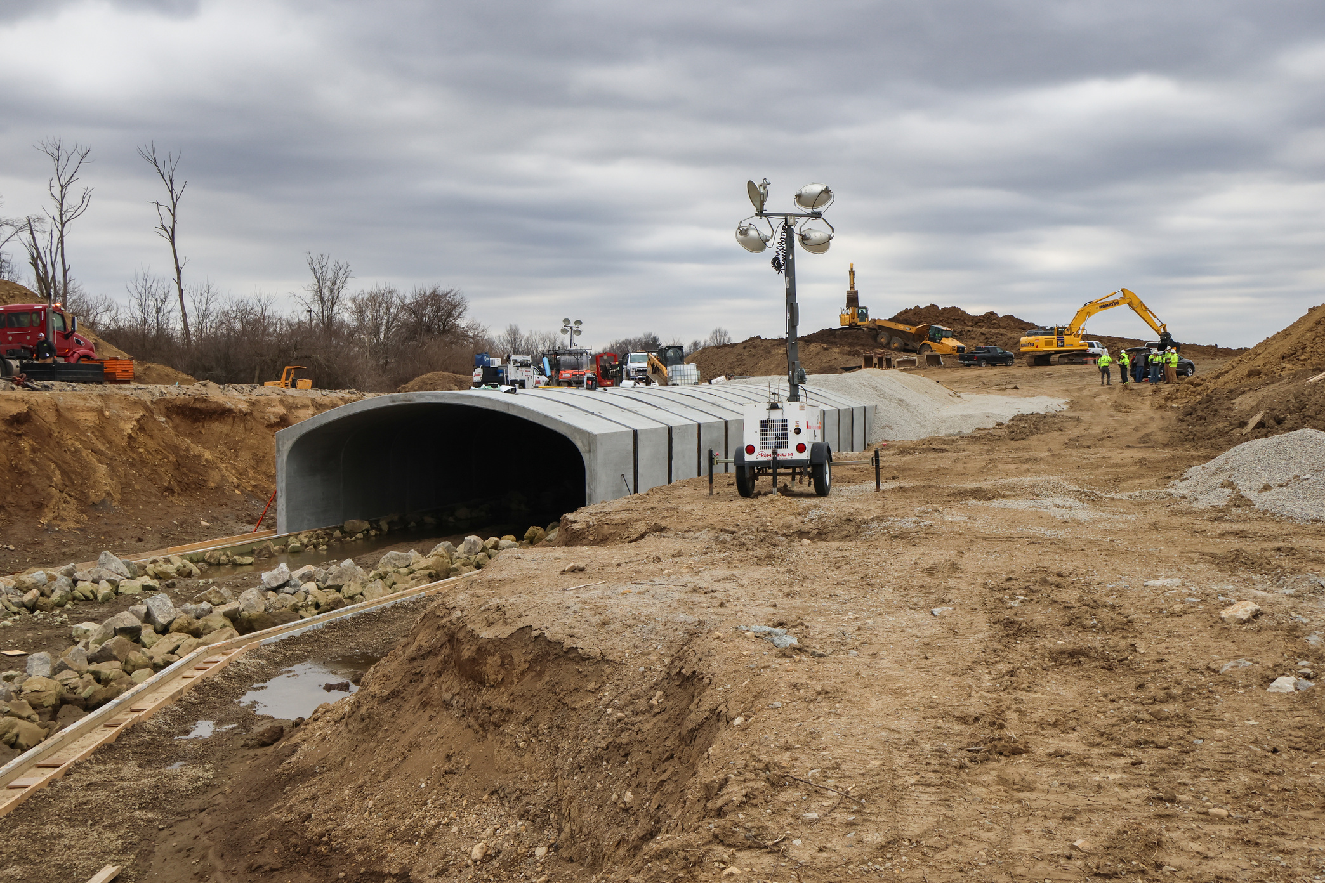
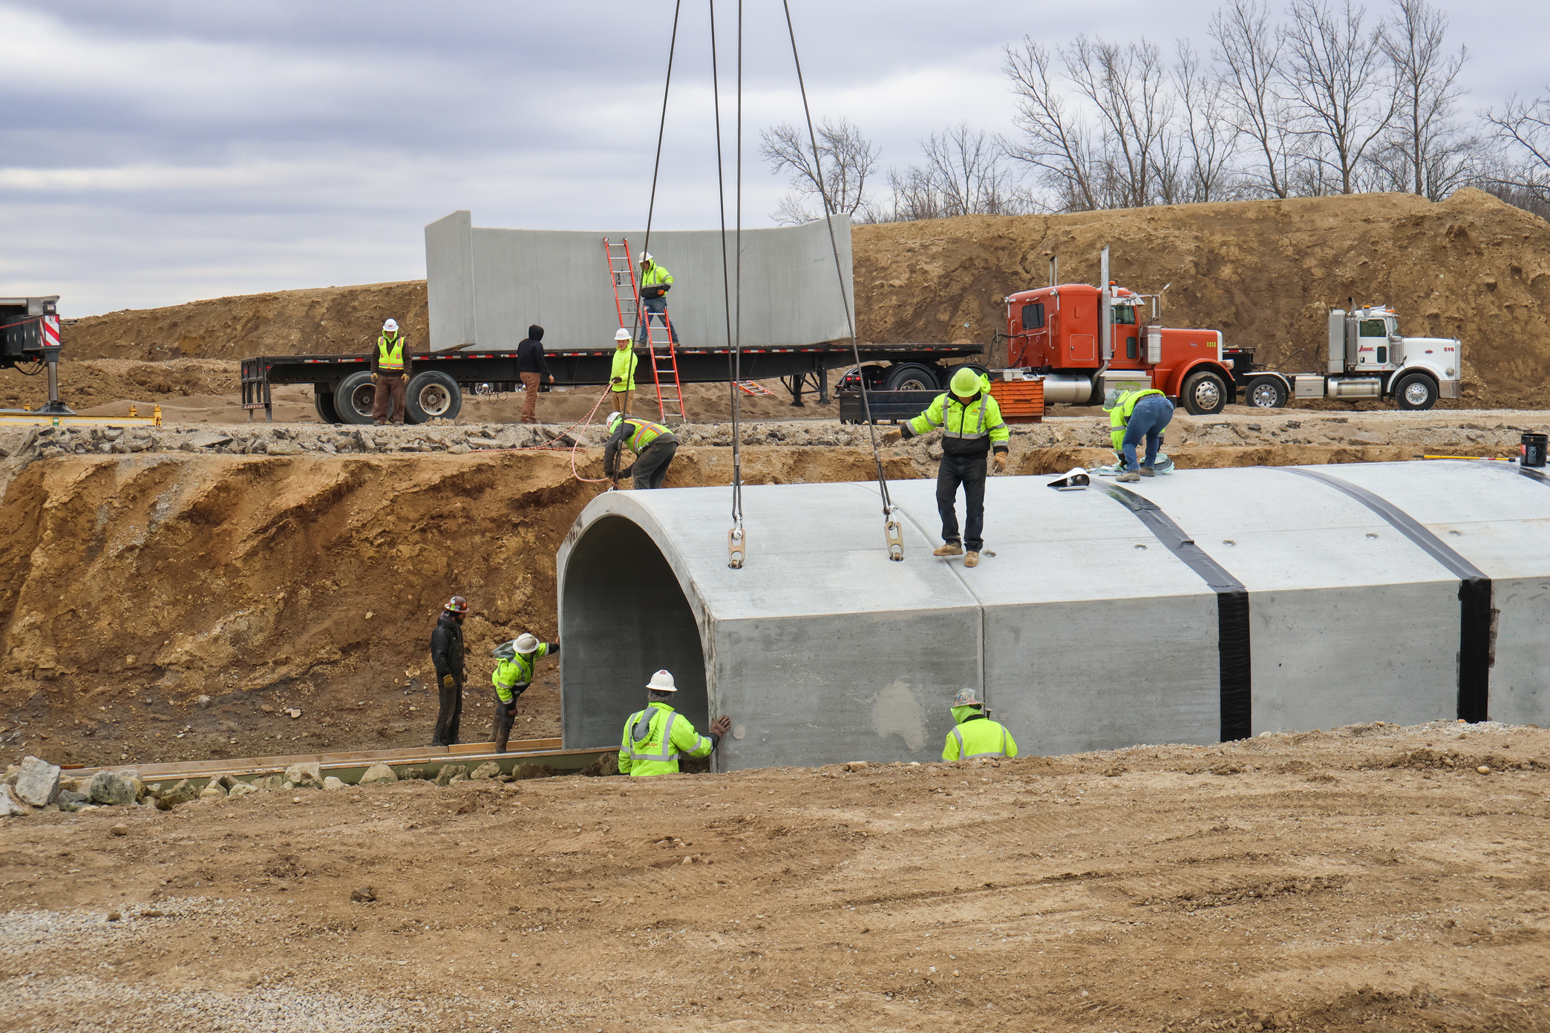
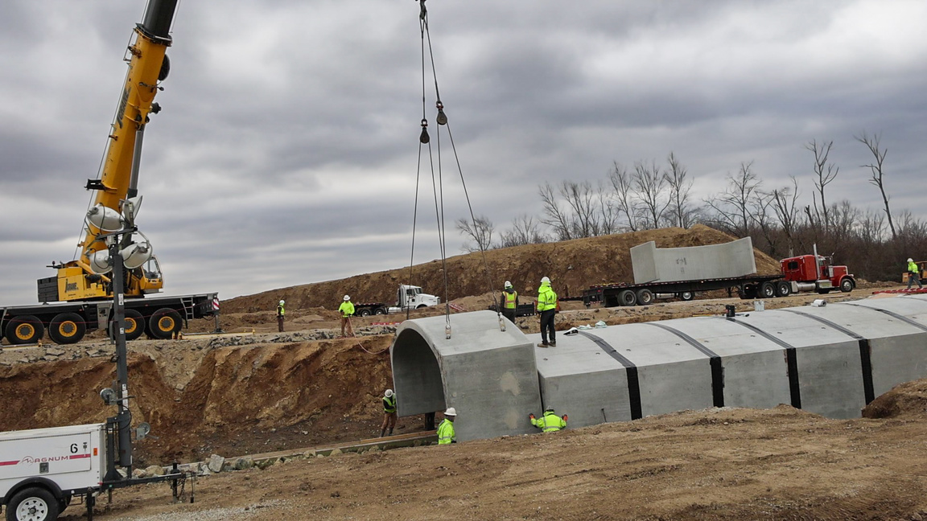
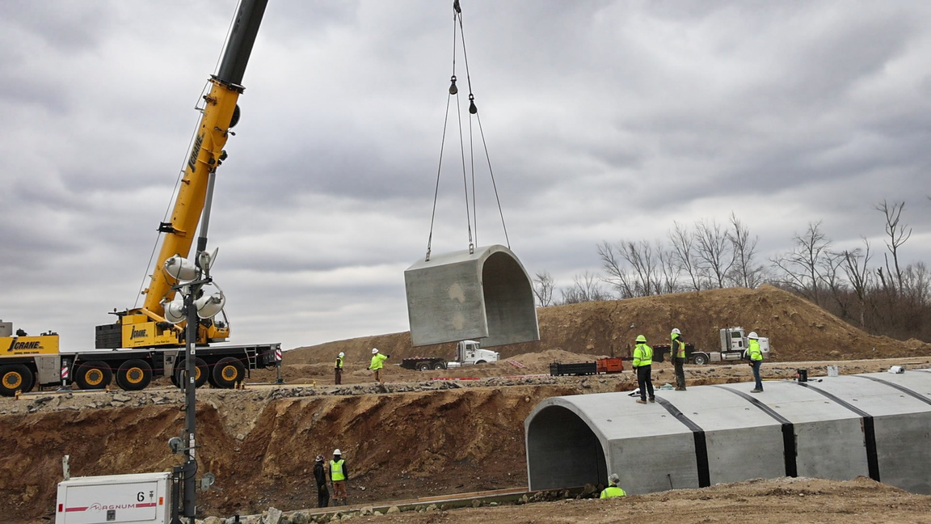

Slide 40
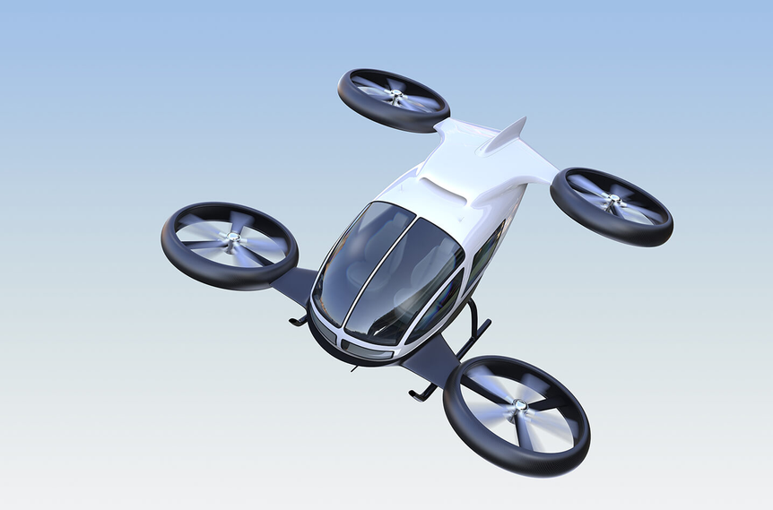

Advanced Air Mobility (AAM)
$9B Industry by 2030

Slide 41
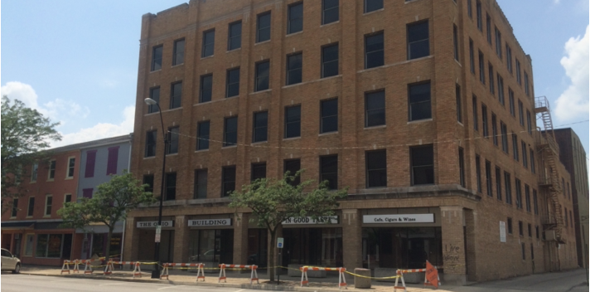
Major Projects
Ohio Building
Redevelopment
  101-Year-Old Building
  5 Story - Mixed-Use
  Downtown
24

Slide 42
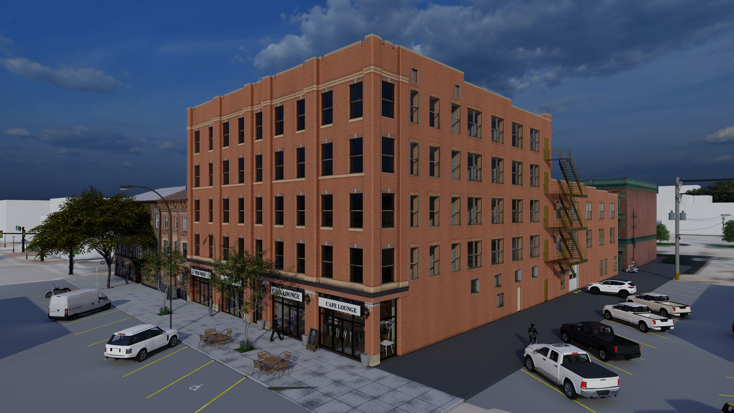

Slide 43
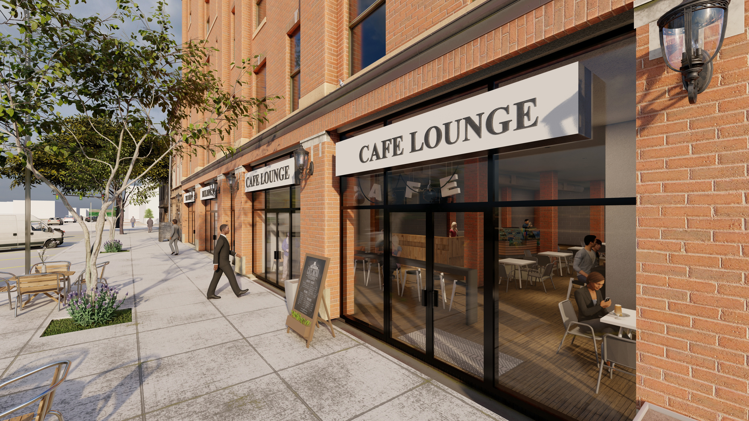

Slide 44
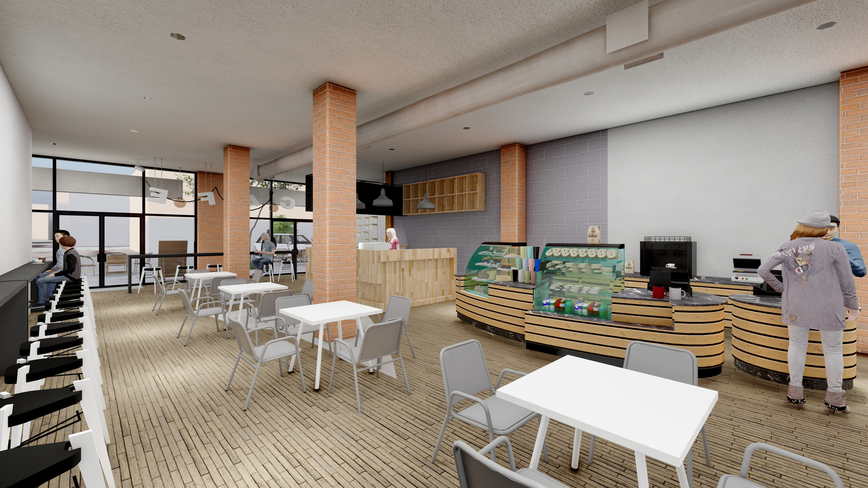

Slide 45
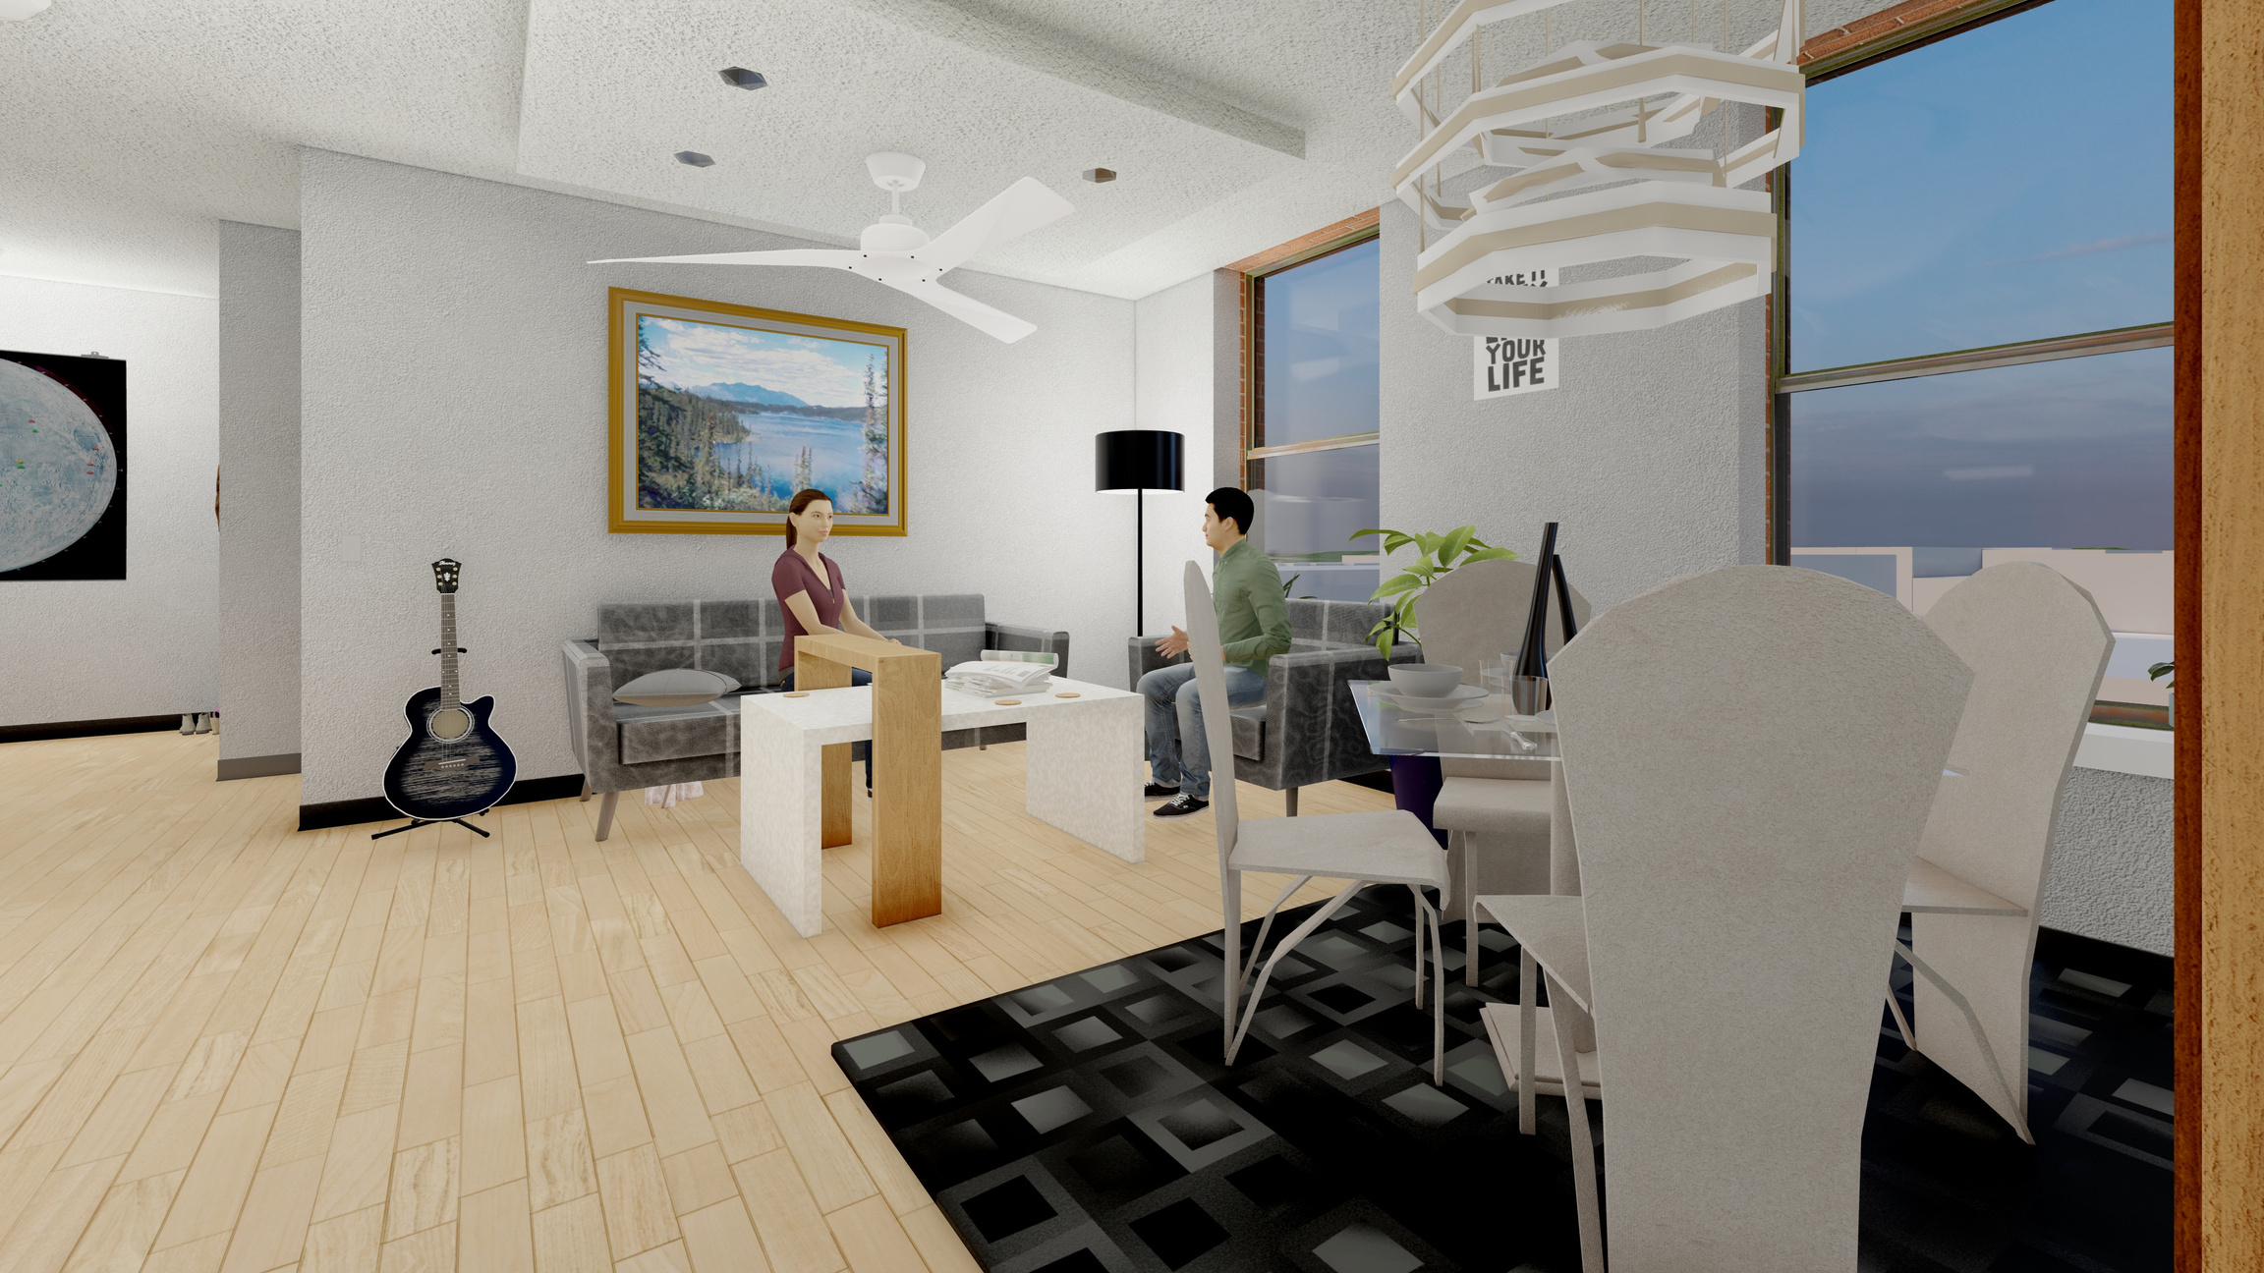

Slide 46
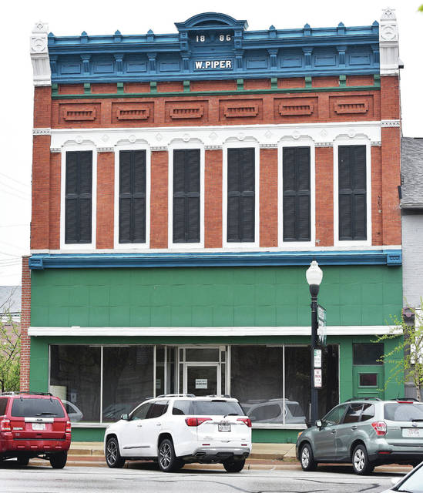
City of Sidney, 2024
Major Projects
Piper Building
Redevelopment
  Mixed-Use
  Downtown
  Family-Friendly
37

Slide 47
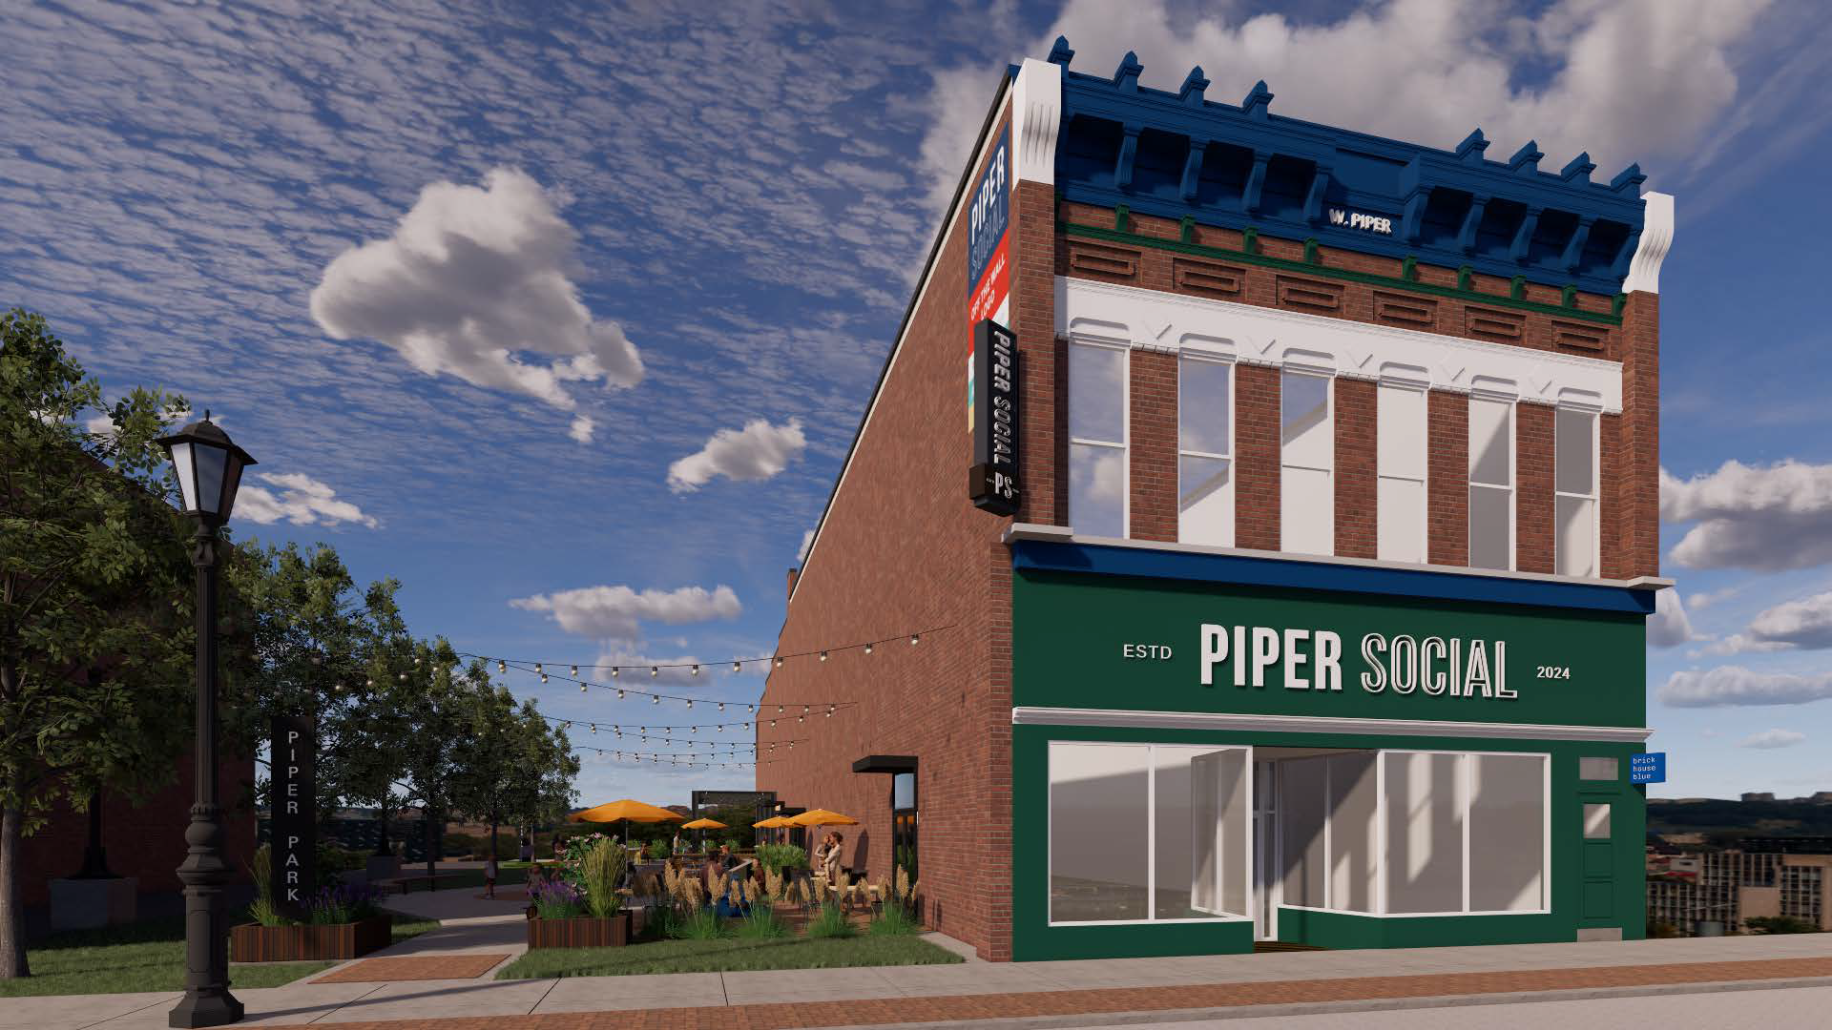

Slide 48
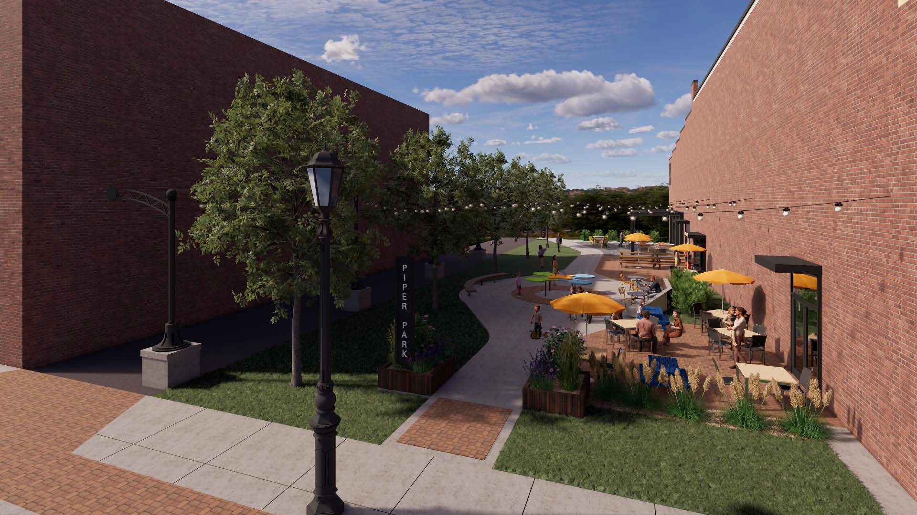

Slide 49
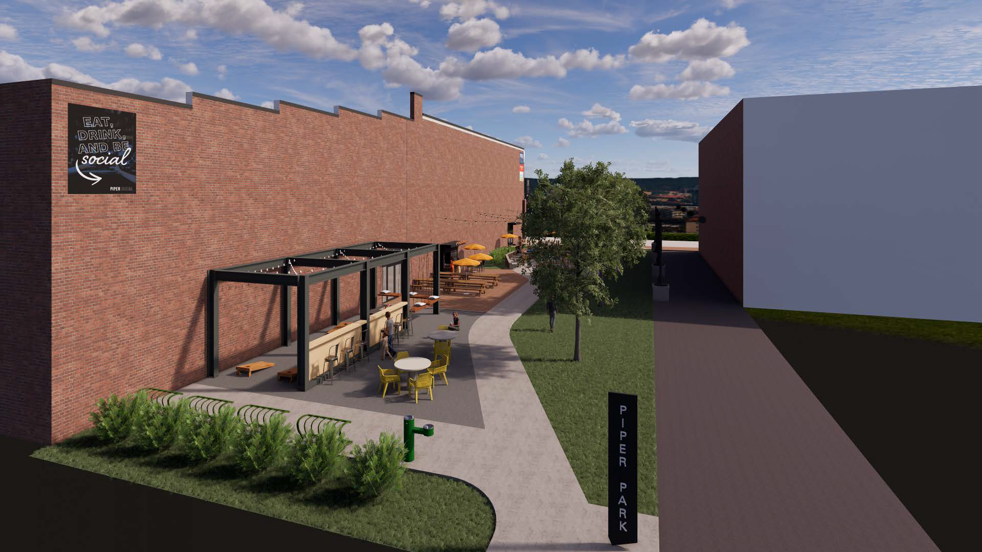

Slide 50
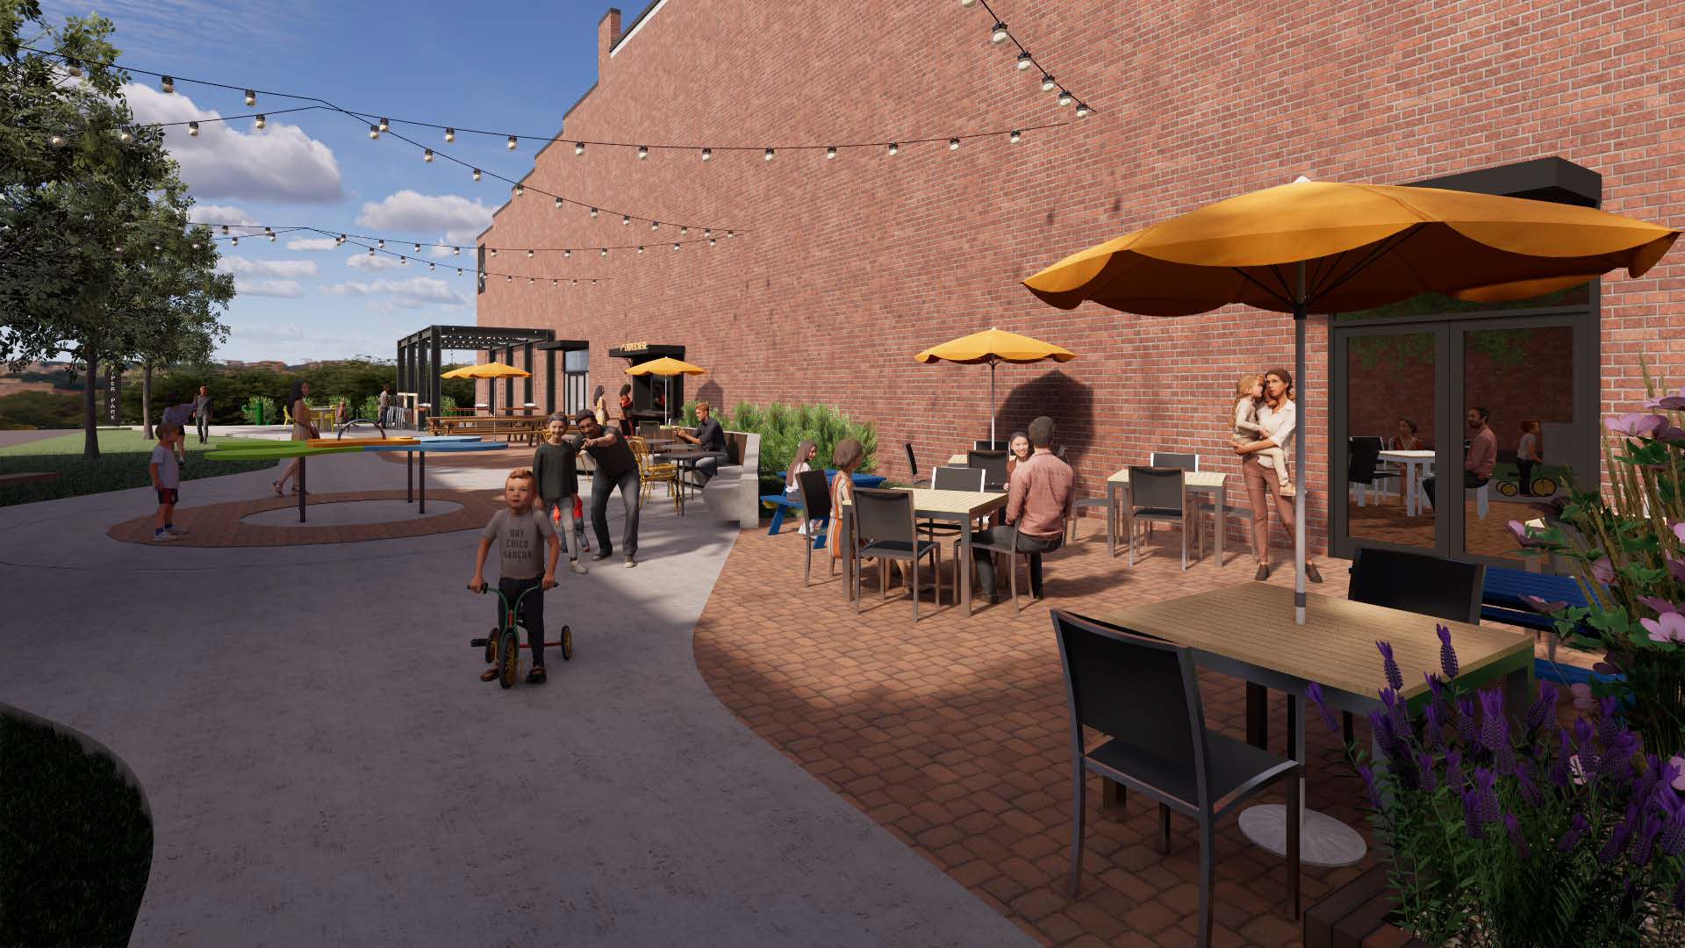

Slide 51
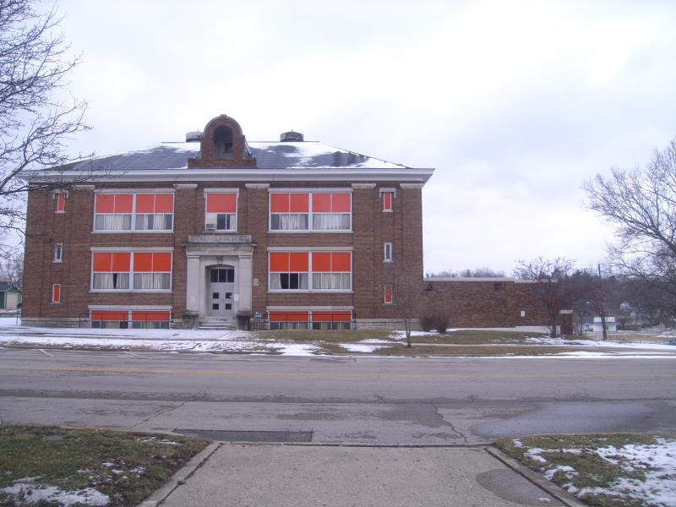
City of Sidney, 2024
Major Projects
Central School
Redevelopment
  Mixed-Use
  Downtown
  Housing
42

Slide 52
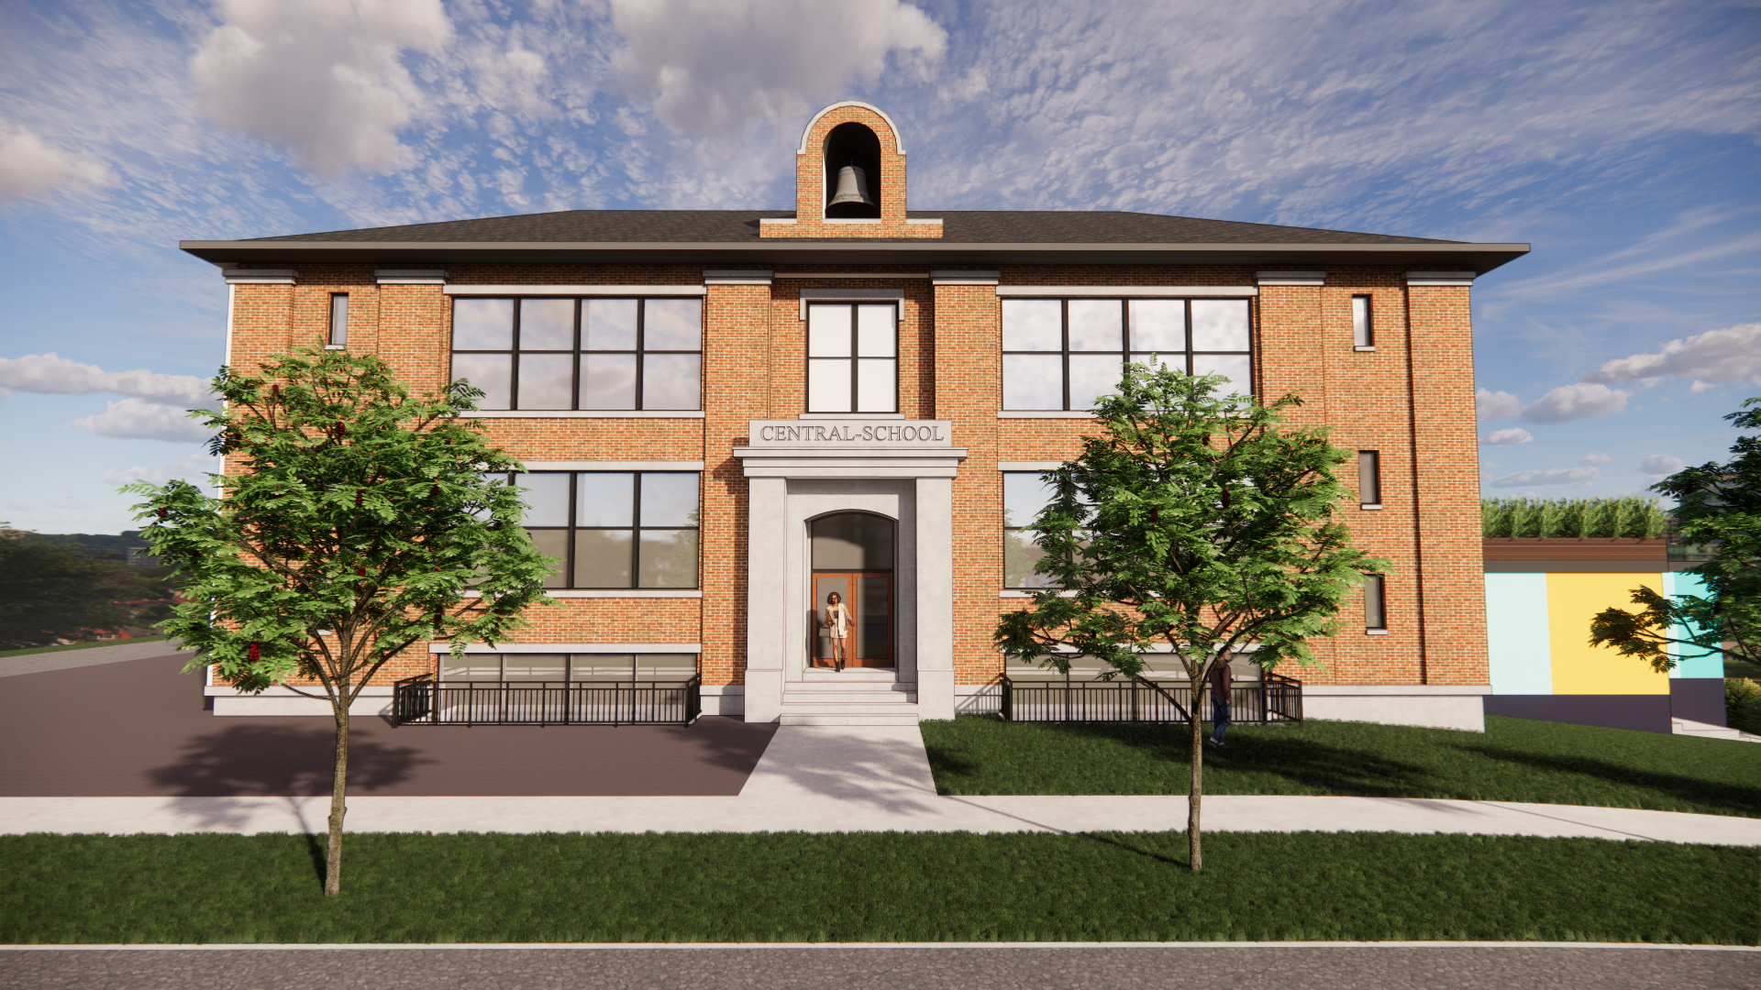

Slide 53
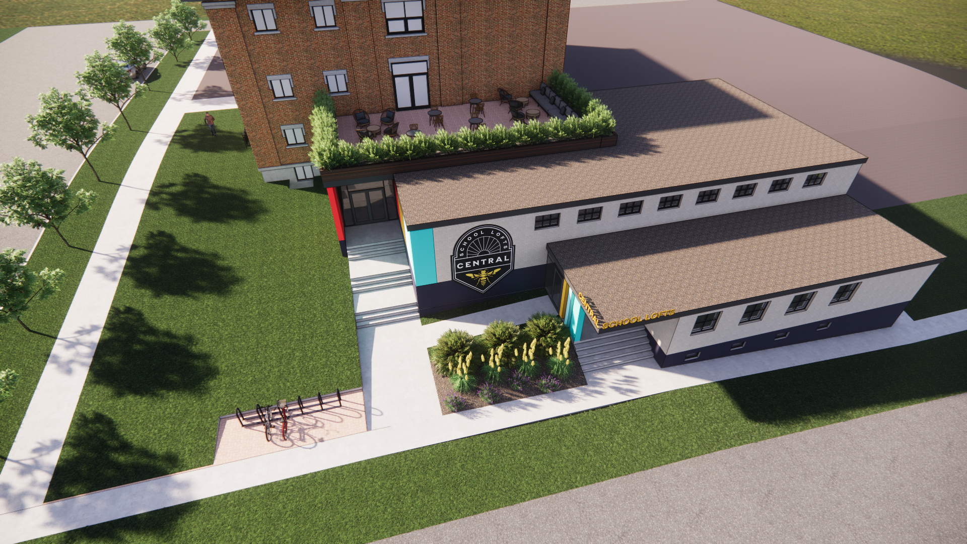

Slide 54
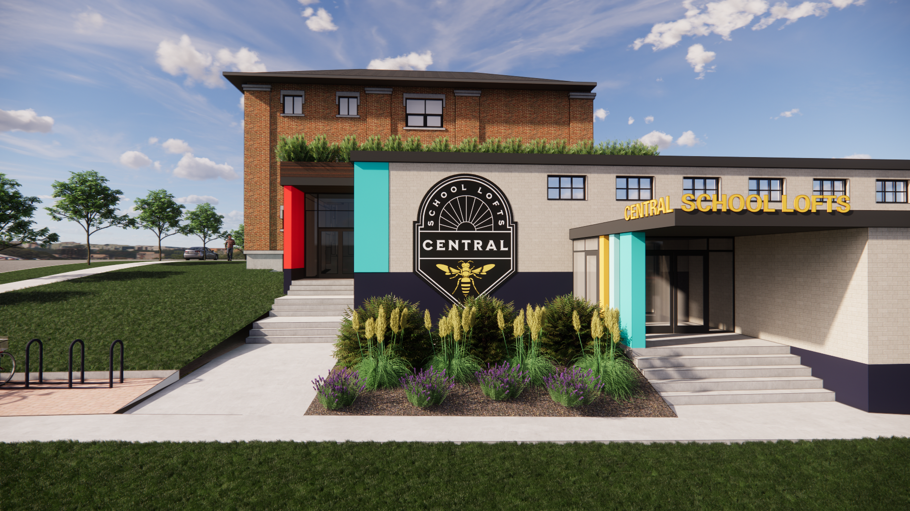

Slide 55
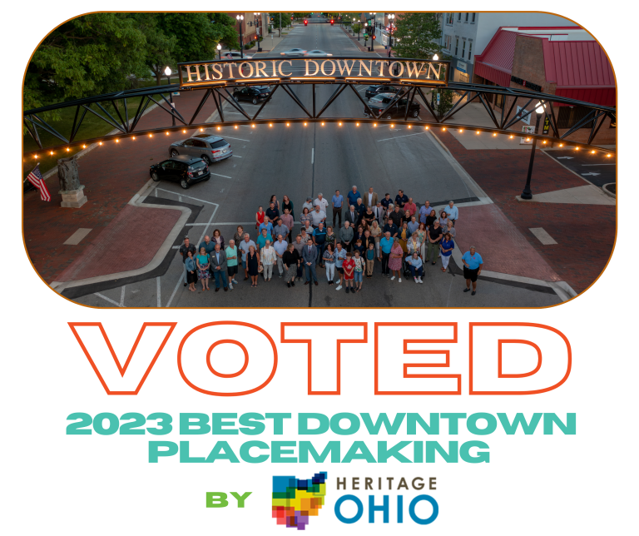

Slide 56
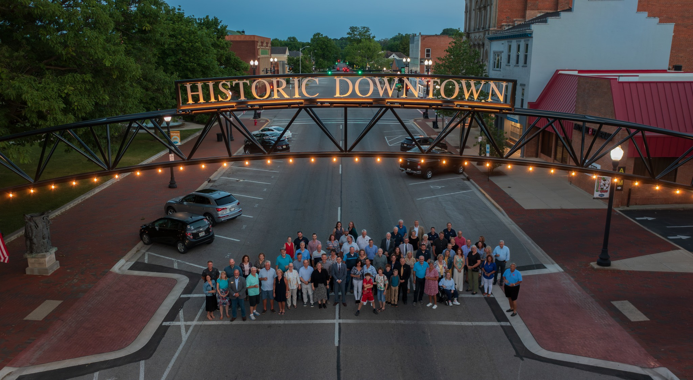

Slide 57


Slide 58

Wayfinding
29

Slide 59


Slide 60




BUSINESS
DEVELOPMENT
  Tax Increment Financing (TIF)
  Enterprise Zones (EZ)
  Community Reinvestment Area (CRA) agreements
  Municipal Job Creation Tax Credit program
  Municipal Water Rebate program
  Community Development Block Grant (CDBG) Economic Development grant/loan
  Port Authority Co-operative agreements
COPELAND
CARGILL
Copeland is completing a 4-year $100 million renovation and expansion of its Sidney location.
Creation and expansion of almost ~$300 million in development

Slide 61



MICHIGAN METAL COATINGS
KLINGER
THERMOSEAL
NK PARTS
  60 Jobs
  $3.5M Payroll
  Tier 1 Automotive
  $2M Expansion
  Expanded Engineering
  Polymer Products
  $6.5M Expansion
  785,000 sq.ft.
  Automotive Logistics

Slide 62
City of Sidney, 2024
Next Steps
Where do we go from here? The City of Sidney is poised to continue being an economic powerhouse of manufacturing and innovative jobs.
Forward Thinking
Communication / Future Building
Comprehensive Planning
The City will now strive to make technology a main factor within our government, whether it's online bill pay, ERP, ESS, Online Taxes, digital contractor registration, or smartphone presentations.
We must be a City ready to take on the challenges of tomorrow and build a better community for our children and beyond. This includes working with businesses at a business pace.
The priorities outlined and the dozens of others in the City will continue to be at the forefront of all decision-making. Comprehensive Plan update for 2024 is underway
48

