Slide 1

Office of Compliance Assistance & Pollution Prevention
(OCAPP)
Services
Amber Hicks, OCAPP
May 8, 2019

Slide 2

What is OCAPP?
Office of Compliance Assistance &
Pollution Prevention
Non-regulatory
Free & Confidential
Focusing on the needs
of small businesses
One-stop shop for confidential waste reduction and regulatory assistance
Notes:
Some of the services OCAPP can provide to the businesses in your area

Slide 3


Finding Help
P2
Technical/Compliance Assistance
Funding
Helping our CUSTOMERS
get from here
to HERE
Notes:
Assist both businesses and communities

Slide 4
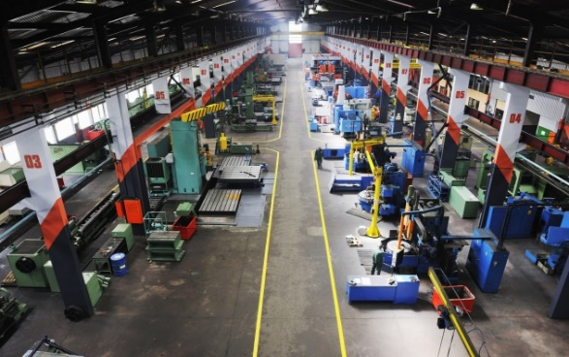
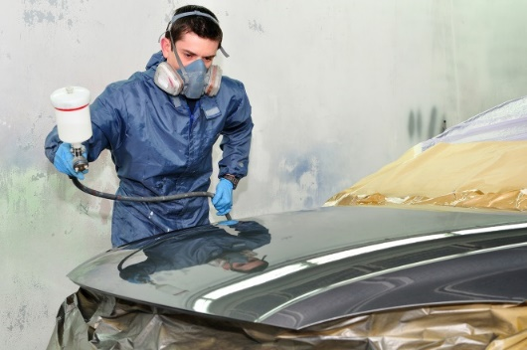
OCAPP Services
OCAPP works with small businesses to help them understand and address their environmental compliance responsibilities
OCAPP works with businesses of all sizes to provide general compliance assistance & identify ways of reducing waste/emissions – saving money

Slide 5
What OCAPP can do for small businesses
Provide regulatory technical assistance via phone/e-mail - Not subject to public records!!!
Help complete and submit permit applications and reports for small businesses
Develop and help maintain on-site records

Slide 6

What OCAPP can do for small businesses
Conduct free on-site compliance assessments for small businesses - Held in strict confidence!!!
Program specific or multi-media
Conduct waste reduction visits

Slide 7

What kind of small business?
Sole proprietorship with less than 100 employees
Types of businesses we may help:
Auto Body Shops
Motor Vehicle Salvage Yards
Small Manufacturing facilities

Slide 8
OCAPP Services
Workshops, trainings & conferences
Develop publications (plain-English)
Quarterly newsletter
Web resources (Permit Wizard, Answer Place, Publications catalog)
Small Business Environmental Compliance Self-Assessment Guide

Slide 9
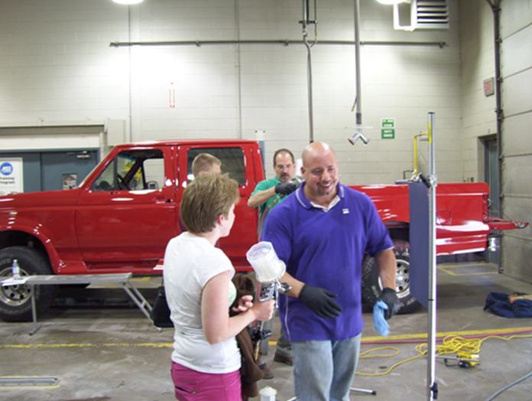
Notice of Violation?
OCAPP can serve as a liaison between the inspector and business to facilitate compliance
OCAPP staff are not the facility’s counsel in providing assistance

Slide 10

We offer the ability to talk with an Environmental Specialist
Compliance assistance hotline:
Toll-free
(800) 329-7518
8:00-5:00 M-F

Slide 11

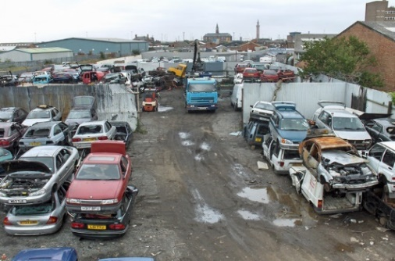
Specific Examples of assistance
Help an auto body shop receive an air permit for their paint booth
Help a new small business determine what permits may be required
Help a scrap tire hauler obtain their registration
Help a motor vehicle salvage yard obtain their NPDES storm water permit

Slide 12

Waste reduction to avoid regulation and save $$$
Pollution Prevention (P2)
  Waste minimization & P2
  On-site assessments
  Off-site assistance (email, phone, Web info)
Other resources
  P2 documents & guidance
  Online training for metal finishing,
  painting, sustainability, etc.

Slide 13

Ohio Materials Marketplace
Online platform for materials exchange
Connect and find reuse & recycling solutions
Post available or wanted materials
Identify reuse opportunities
Exchange underutilized materials
One man’s “trash” is another man’s treasure!
https://ohio.materialsmarketplace.org/
Contact: Frank Basting, OCAPP, Sustainability Unit 614-644-3544 frank.basting@epa.ohio.gov

Slide 14



Show me the money!!

Slide 15



Office of Financial Assistance (OFA)
Administers both state revolving loan fund programs
  Water Pollution Control Loan Fund (WPCLF)
  Water Supply Revolving Loan Account (WSRLA)
Administers the recycling/litter prevention grant program
Administers the wastewater treatment facility compliance assistance program

Slide 16

Recycling and Litter Prevention
The Recycling & Litter Prevention (R&LP) grant program supports communities and businesses that initiate or expand programs, facilities and operations that will strengthen recycling markets
The program provides approximately $3 million annually in grant funding to encourage sustainable practices, stimulate economic growth and support litter prevention efforts
Contact:
Katie Courtright, ocapp
Recycling & Litter prevention
(614)705-1147
Kathleen.courtright@epa.ohio.gov

Slide 17


Recycling and Litter Prevention Grants
Market Development Grant
  Manufacturers and material processors
  Create or expand the types of recycled products that are marketed
  Funding for equipment needed to remanufacture recyclable materials into bulk raw material or finished products
Scrap Tire Grant
  Manufacturers and material processors
  Create or expand the types of scrap tire products that are marketed
  Funds for beneficial use projects that incorporate Ground Tire Rubber and Recycled Asphalt Shingles

Slide 18
Wastewater Treatment Plant Compliance Assistance Unit
Non-regulatory, free
Provide compliance assistance to businesses and communities at small WWTPs
Assist local wastewater operators to help ID, troubleshoot and resolve plant operational issues
Perform plant evaluations
Assist with finding solutions for improving plant performance
Training of plant operators
Assist plants achieve compliance as well as lower operating costs
Contact: Jon Bernstein, Office of Financial Assistance
(614)644-3715, jonathan.bernstein@epa.ohio.gov
Notes:
Both for businesses and communities

Slide 19

Recognition Program
Encouraging Environmental Excellence
Encouraging Environmental Excellence (E3) Program
Recognizes companies that go beyond compliance and implement sustainable practices
4 Levels of Recognition
If you’re interested, contact:
Mike Kelley, OCAPP
614-644-2930
michael.kelley@epa.ohio.gov
Application instructions: epa.ohio.gov/ohioE3.aspx
Get rewarded!!

Slide 20

Additional Air Compliance Resource
Ohio Air Quality Development Authority (OAQDA)
The Clean Air Resource Center (CARC)
Not part of the Ohio EPA

Slide 21
Ohio Air Quality Development Authority (OAQDA)
The Clean Air Resource Center (CARC)
Independent, non-regulatory state agency
Not part of Ohio EPA
Functions similar to OCAPP
Provide compliance assistance
Free, confidential
Services the entire state of Ohio

Slide 22
OAQDA / CARC Services
Assists small businesses
Free, confidential on-site air pollution assessments
Funding for air pollution control equipment
One-on-one technical assistance for P2
Financing to purchase air pollution control or prevention equipment
  Loans, tax abatement programs
  Auto body shops (updated paint booths)
  Dry cleaners (cleaner emissions/no perc cleaners)
Grants

Slide 23
OAQDA / CARC Services
Assists large businesses
  Tax incentives for investment in cleaner air and energy efficiency
  Energy efficiency improvements, process changes, or purchase of traditional air pollution control equipment

Slide 24
OAQDA / CARC
Ohio Air Quality Development Authority
50 West Broad Street, Suite 1718
Columbus, OH 43215
(614) 224-3383
www.ohioairquality.org
Clean Air Resource Center
Small Business Hotline 800-225-5051
(614) 728-3540

Slide 25
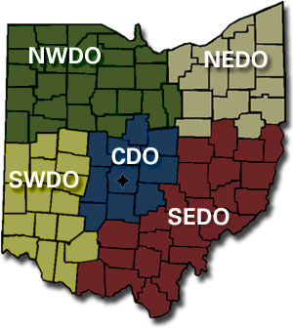
Contact and assistance information
Office of Compliance Assistance & Pollution Prevention
www.epa.ohio.gov/ocapp
(800)329-7518
Division of Environmental & Financial Assistance
http://www.epa.ohio.gov/defa/EnvironmentalandFinancialAssistance
(614)644-2798

Slide 26


Questions?
OCAPP: Free & confidential hotline
(800)329-7518
www.epa.ohio.gov/ocapp
Southwest Ohio OCAPP Contact
Maddie Adams
(937)285-6456
madelyn.adams@epa.ohio.gov
Southwest Ohio OCAPP Contact
Amber Hicks
(937)285-6439
amber.hicks@epa.ohio.gov

Slide 27
eBusiness Center Assistance https://ebiz.epa.ohio.gov
(877) 372-2499
Air Services Assistance (Division of Air Pollution Control Reporting)
Safaa El-Oraby
(614)644-3571
safaa.el-oraby@epa.ohio.gov
Linda Lazich
(614)644-3626
linda.Lazich@epa.ohio.gov
STREAMS/eDMR Assistance (Division of Surface Water Reporting)
Katherine Harris
(614)644-2135
katherine.harris@epa.ohio.gov
Cole Miller
(614)728-3846
cole.miller@epa.ohio.gov

Slide 28
Regulatory Staff/Agencies
Miami County
Ohio EPA, Division of Surface Water Primary Contact
Maureen ware
(937)285-6104
Maureen.ware@epa.ohio.gov
Ohio EPA, Southwest Ohio Storm water Contact
Michelle Flanagan
(937)285-6440
michelle.flanagan@epa.ohio.gov
Ohio EPA, Southwest District Office
(937)285-6357
http://epa.ohio.gov/districts.aspx#115772916-southwest
Air Pollution Control
Regional air pollution control agency
(937)225-4435
Https://www.rapca.org/

Slide 29

Regulatory Staff
Shelby County
Ohio EPA, Division of Surface Water Primary Contact
Maureen ware
(937)285-6104
Maureen.ware@epa.ohio.gov
Ohio EPA, Southwest Ohio Storm water Contact
Michelle Flanagan
(937)285-6440
michelle.flanagan@epa.ohio.gov
Ohio EPA, Southwest District Office
(937)285-6357
http://epa.ohio.gov/districts.aspx#115772916-southwest
Ohio EPA, Division of Air pollution Control Primary Contact
Melanie Ray
(419)373-4111
Melanie.ray@epa.ohio.gov
Shelby County Air Pollution Control OCAPP contacts
Tom cikotte
(419)373-3020
Thomas.cikotte@epa.ohio.gov
Jeremy scoles
(419)373-3095
Jeremy.scoles@epa.ohio.gov

